Slide 1
Department of Municipal Development CIP Bidding and Contract Book Overview June 14, 2022

Slide 2
Background
1975 – creation of a Capital Improvements Program (CIP).
1996 – scope of the capital program was broadened and renamed the “Capital Implementation Program” (CIP).
2003 – The Department of Municipal Development (DMD) was created to lead the way in completing important projects on schedule and on budget for all City residents.

Slide 3
CIP Mission
To enhance the physical and cultural development of the City by implementing the Albuquerque/Bernalillo County Comprehensive Plan and other adopted plans and policies. Through a multi-year schedule of public physical improvements, CIP administers approved Capital Expenditures for systematically acquiring, constructing, replacing, upgrading and rehabilitating Albuquerque’s built environment.

Slide 4
Capital Implementation Program (CIP)
CIP develops, and sometimes directly implements, diverse projects that enhance every aspect of the daily lives of all our citizens.
Expansion of police, fire and emergency response systems
Rehabilitation of aging infrastructure such as roads, drainage systems and the water and wastewater network.
Additions and improvements to recreational spaces such as zoo, libraries, museums, athletic facilities, parks and trails
Meal sites, and Senior, Community and Multiservice Centers

Slide 5
Capital Implementation Program (CIP)
Funding – General Obligation Funds (G.O. Bonds), Enterprise Funds, Metropolitan Redevelopment Funds, Federal and State grants.
$246,294,016.97 CIP Construction projects awarded in the last two years.
https://www.cabq.gov/municipaldevelopment/

Slide 6
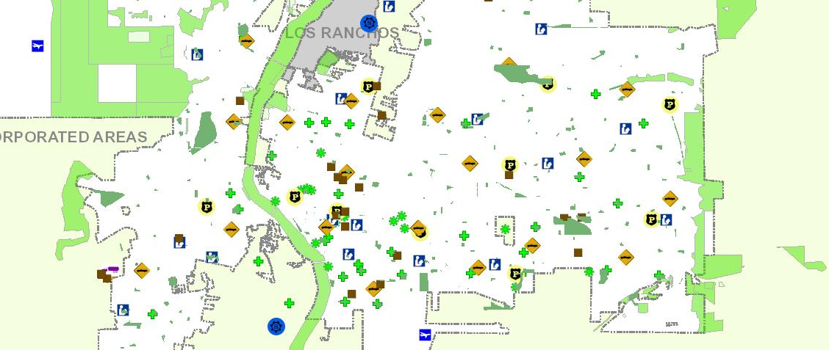
Map of City Facilities

Slide 7
Inventory of City Properties
2.2 Million Sq./ft Managed by Facilities
Airport
4 Museums
Bio Park
2 Performing Art Centers
23 Community Centers
18 Libraries
12 Pools
298 Parks
30,000 acres of Open Space
153 Miles of paved trails
4,668 lane miles of roadway, 200 bridges & 658 signals
765 miles of storm drain pipe, 32,436 storm drain inlets, 110 drainage ponds, 12 dams, 80 miles of arroyos

Slide 8
How Much Does the City Spend on Design and Construction
Construction Funding Sources
General Obligation Bonds
Federal Grants (Transportation, CDBG, Aviation, EPA?)
1/8 and ¼ Cent Tax Increase for Bio Park and Transportation
State Grants
GRT Bonds

Slide 9
Bidding and Construction Contracts
Albuquerque Code of Ordinances Section 5-5-4 – “Public Purchases Ordinance”
https://www.cabq.gov/dfa/purchasing-division
Regulations Governing the Award and Rejection of Bids/Offers and Debarment of Contractors for Public Works Projects of the City of Albuquerque, effective January 22, 2021 (“Regs”)
https://www.cabq.gov/municipaldevelopment/architects-engineers-contractors/cip-construction-information
City of Albuquerque Standard Specifications for Public Works Construction 2020 Edition, as amended
https://www.cabq.gov/planning/building-development-services/design-review-construction-forms

Slide 10
Bidding and Construction Contracts
The General Conditions of the City of Albuquerque Standard Specifications for Public Works Construction 2020 Edition, as amended by the Supplemental General Conditions (see SGC-1 through SGC-8 of the boilerplate)
Subcontractor’s Fair Practices Act Section 13-4-31, et seq., NMSA 1978 (“SFPA”)

Slide 11
Procurement Methodology
Deputy Director determines the appropriate procurement methodology for procurements managed by the CIP Division
Design Bid Build Delivery Method
Competitive sealed bids – Request for Bids (RFB)
Competitive sealed proposals – Request for Proposals (RFP)
Construction Manager at Risk (CMAR)
For Public Works Projects estimated to cost more than $5,000,000
Requires the use of competitive sealed proposals.

Slide 12
Bidding Schedules – Request for Bids
Non-federal:
Week 1 – Advertisement
Week 2 – Advertisement
Week 3 – Pre-bid Conference
Week 4 – Final Addenda
Week 5 – Bids Due
Week 6-7 – Notice of Award
Week 8-9 – Contract Book
Week 10 – Notice to Proceed
Federal funding:
Week 1 – Advertisement
Week 2 – Advertisement
Week 3 – Advertisement
Week 4 – Pre-bid Conference
Week 5 – Final Addenda
Week 6 – Bids Due
Week 7-9 – Notice of Award
Week 10-11 – Contract Book
Week 12 – Notice to Proceed

Slide 13
Bidding Schedules – Request for Proposals
Ad Hoc Committee Evaluation only
Week 1 – Advertisement
Week 2 – Advertisement*
Week 3 – Pre-proposal Conference
Week 4 – Final Addenda
Week 5 – Proposals Due –
Week 6 – Ad Hoc Advisory Committee Meeting to discuss and finalize Technical Proposal scores
Week 7-8 – Notice of Award
Week 9-10 Contract Book
Week 11 – Notice to Proceed
*If Federal funding, add one week of advertising
Including Contractor Interviews
Week 1 – Advertisement
Week 2 – Advertisement*
Week 3 – Pre-proposal Conference
Week 4 – Final Addenda
Week 5 – Proposals Due
Week 6 – Ad Hoc Advisory Committee Meeting – to discuss and finalize Technical Proposal scores; create shortlist, discuss and develop Interview format, questions, and points
Week 8 – Interviews and final Ad Hoc Committee meeting and Interview scores
Week 9-10 – Notice of Award
Week 11-12 Contract Book
Week 13 – Notice to Proceed

Slide 14
Advertisements
Albuquerque Journal – published in the Legal Notices on two consecutive Wednesdays, three if federally funded.
Academy Reprographics – new projects are added to the Public Jobs online Planroom on Wednesdays
https://www.academyplans.com/jobs/public
DMD Website – new projects are added on Thursdays
https://www.cabq.gov/municipaldevelopment/architects-engineers-contractors/cip-solicitations
Twitter – new projects are tweeted on Thursdays, @abqdmd
https://twitter.com/abqdmd

Slide 15
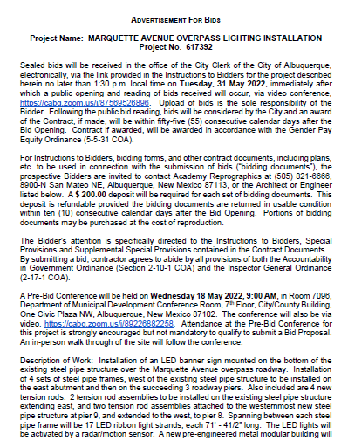
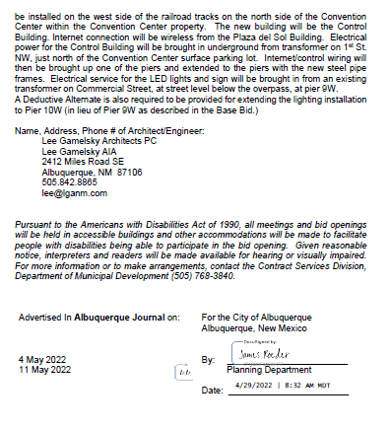

Slide 16
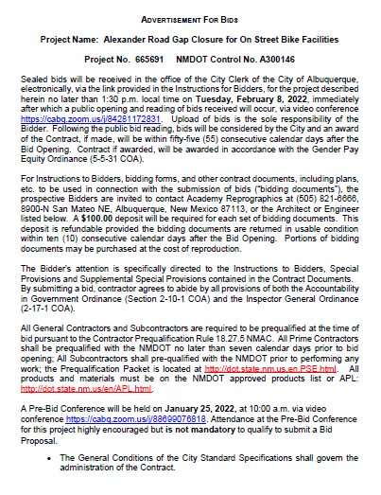
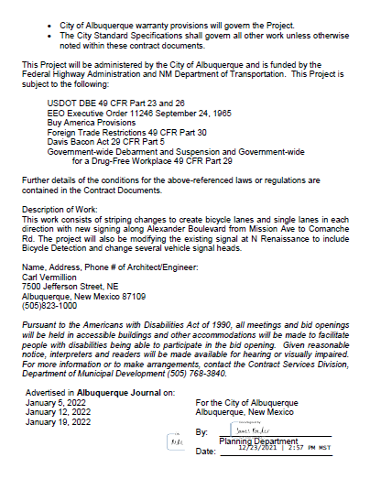

Slide 17
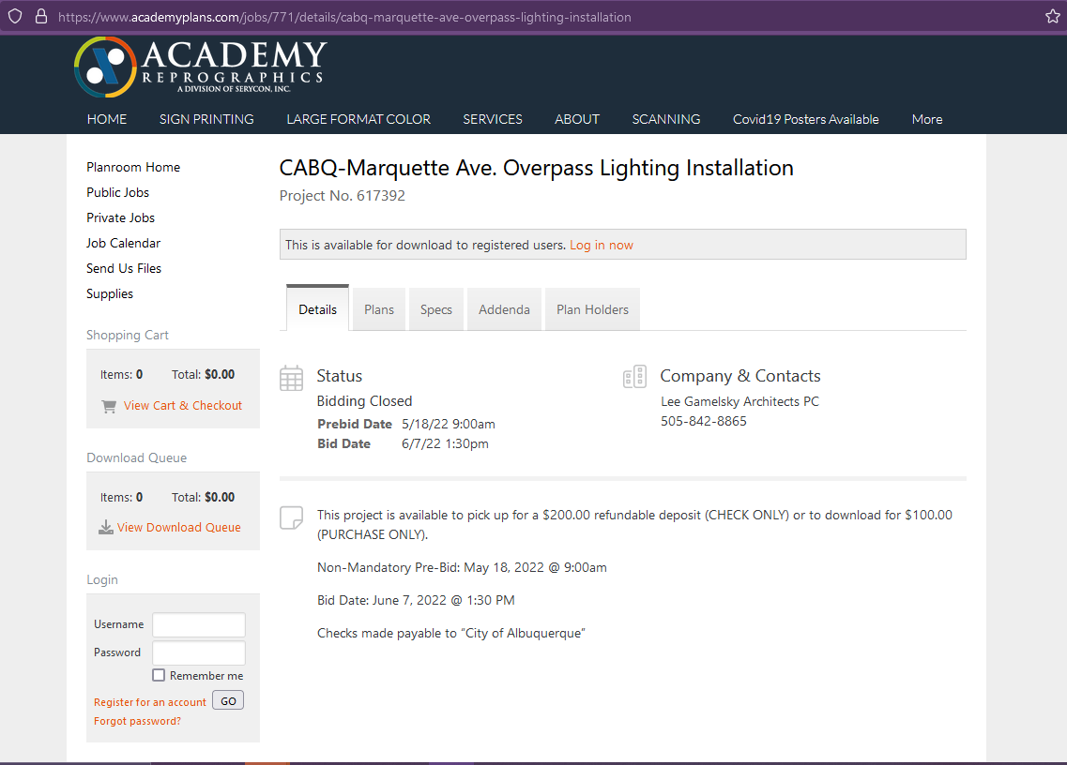

Slide 18
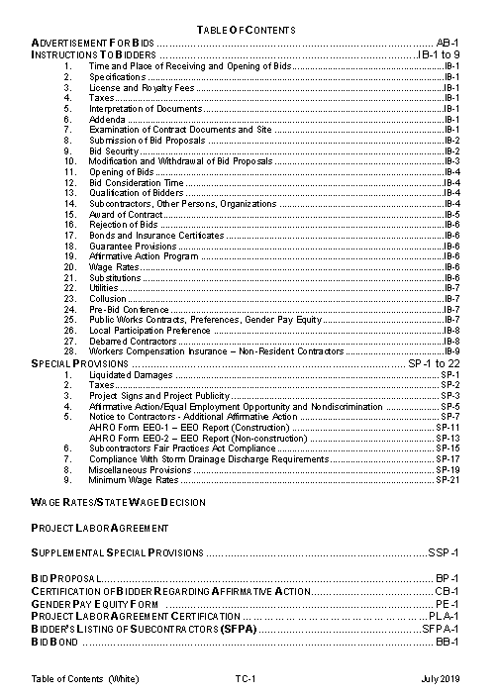
Table of Contents
No Federal Funding
Includes Project Labor Agreement

Slide 19
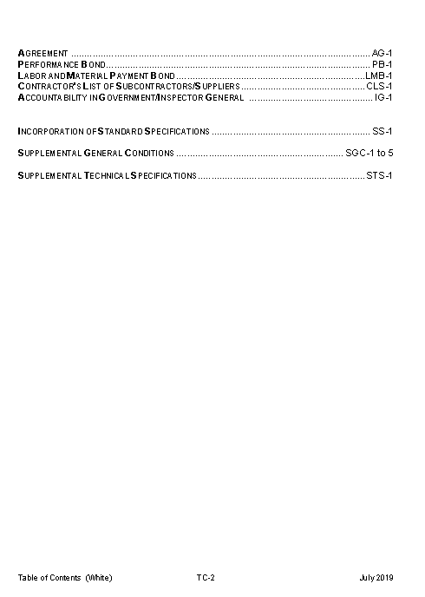

Slide 20
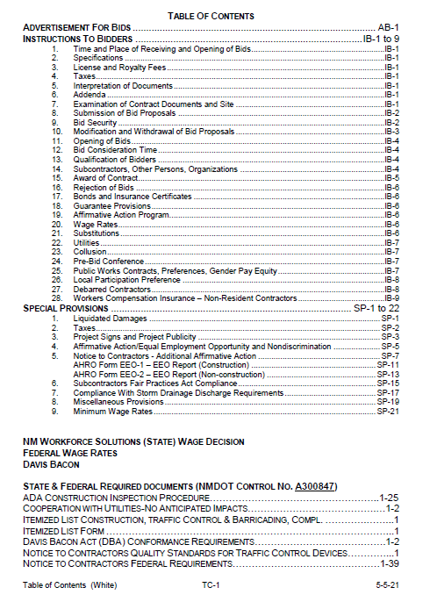
Table of Contents
Federal Funding
Federal Wage Rates
State and Federal Notices and forms

Slide 21
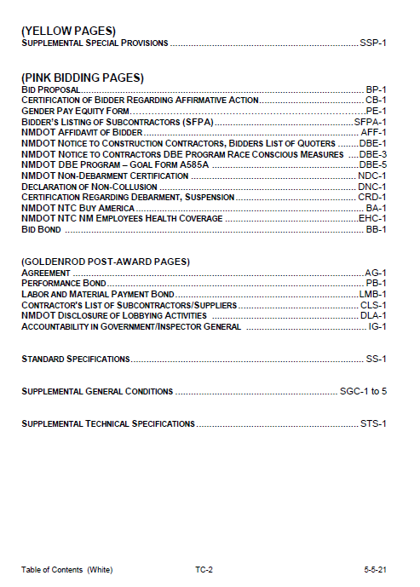

Slide 22
Instructions to Bidders
Interpretation of Documents
Deadline for asking questions, or requesting clarifications. Usually seven (7) working days before the time of opening of bids.
Responses issued via Addendum. No verbal response shall be binding.
Addendum issued through Academy Reprographics. Final - two working days prior to bid due date and time.
Submission of RFB - Bid Proposals or RFP - Cost and Technical Proposals
Instructions for submitting a bids or proposals.
Other requirements – for example, pre-qualifications with the NMDOT
Link for bids or proposals to be uploaded. CityClerk@cabq.gov

Slide 23
Instructions to Bidders
Correction or Withdrawal of Bid Proposals – under what circumstances can bids or proposals be corrected or withdrawn without forfeiture of bid security
Project Labor Agreements – required for Public Works Construction Projects where the total project cost is anticipated to exceed $10,000,000, and where at least three crafts will be employed.

Slide 24
Instructions to Bidders
Subcontractor Requirements
List of Subcontractors submitted with bid
City may request experience statements and other evidence of qualification for each Subcontractor.
If the City has reasonable objection to any proposed Subcontractor, after due investigation and prior to issuing Notice of Award, the City may request an acceptable substitute without an increase to the bid amount.
Bonds – after Notice of Award
Performance Bond 100% amount of contract
Labor and Material Payment Bond 100% amount of contract
On-Calls – Bonds required per Work Order and not the amount of contract

Slide 25
Instructions to Bidders
Insurance Requirements – after Notice of Award
Type of coverage | Limits of Liability | Other Requirements | General Conditions Section
General Liability | $2,000,000 $10,000,000 Aviation | City of Albuquerque and Architect or Engineer is additional insured | §5.2.3
Auto Liability | $1,000,000 | City of Albuquerque and Architect or Engineer is additional insured | §5.2.3
Workers Comp. | Statutory |  | §5.2.5
Builders Risk | Amount of Contract | City of Albuquerque is named as loss payee | §5.2.6.1
Owners/Contractors Protective Liability | $1,000,000 | City of Albuquerque and Architect or Engineer are named insureds | §5.2.4

Slide 26
Instructions to Bidders
Wage Rates
Prevailing wage rates as listed by the Director of the Labor and Industrial Division of the New Mexico Department of Workforce Solutions
Prevailing Federal Wage Rate Decision listed by the U.S. Department of Labor
In effect at the scheduled closing time for receipt of bids
Preferences
Gender Pay Equity Preference 5%
Resident Contractor/Veteran Resident Contractor Preference 5%

Slide 27
Special Provisions
Liquidated Damages
Taxes
Project Signs and Project Publicity
Affirmative Action, Equal Employment Opportunity and Nondiscrimination
Additional Affirmative Action and EEO Employment Data Requirements – Office of Equity and Inclusion oei@cabq.gov
Subcontractors Fair Practices Act Compliance – listing threshold amount for bidding form
Compliance with Storm Drainage Discharge Requirements
Miscellaneous Provisions – Payments, Allowances, Graffiti Removal, Permits
Minimum Wage Rates – Certified Payroll

Slide 28
Supplemental Special Provisions (SSPs)
Makes revisions to the standard provisions of the boilerplate
Contract phasing
Allowances
Site conditions
On-Call procedures
FHWA, NMDOT, FAA, FTA provisions
SSPs will be discussed at the pre-bid conference

Slide 29
Bid Forms (RFB) and Cost Proposal (RFP) Pink pages
Bid Proposal – Unit Price or Lump Sum
Allowances
Alternates – Additive and Deductive. Accepted in the order listed.
Time for award
Contract Time
Liquidated Damages
Signed
Verify that correct version of Bid Proposal is submitted

Slide 30
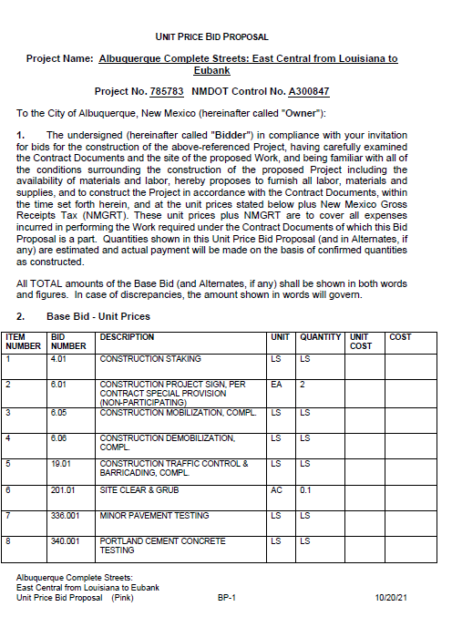
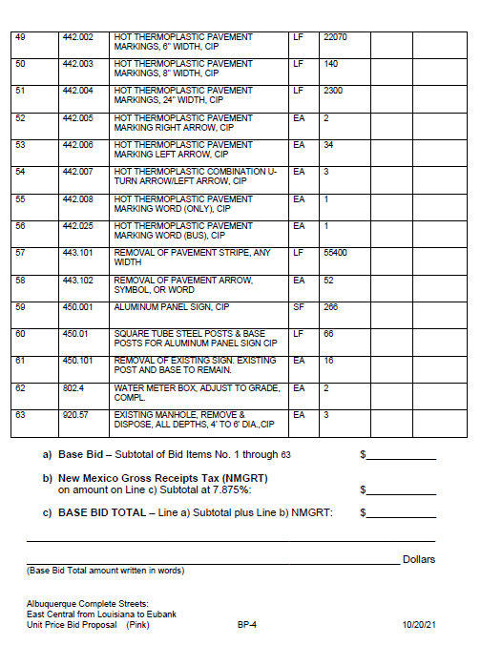

Slide 31
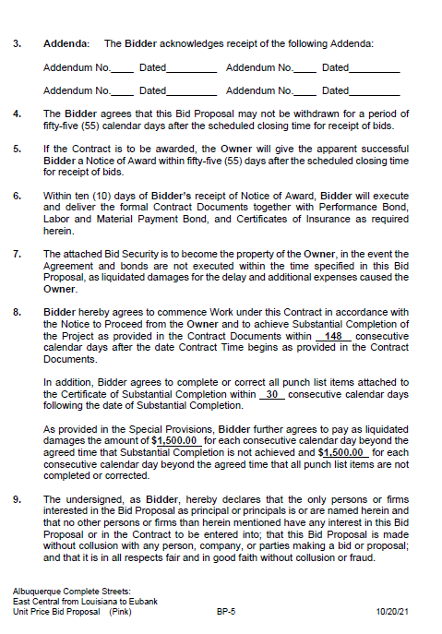
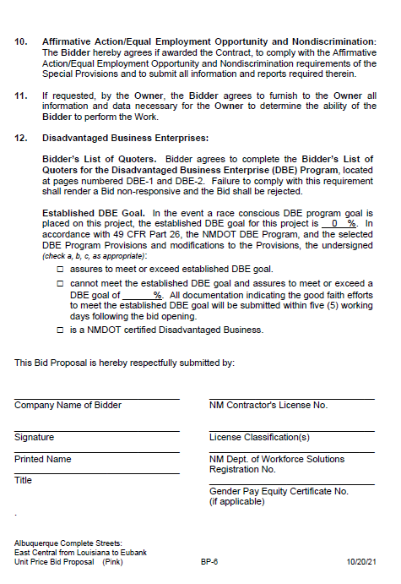

Slide 32
Bid Forms (RFB) and Cost Proposal (RFP)
AHRO Form CC-2 Certification of Bidder Regarding Affirmative Action/Equal Employment Opportunity and Nondiscrimination
Signed
Submit to City of Albuquerque Office of Equity and Inclusion oei@cabq.gov
Pay Equity Reporting Form
https://www.cabq.gov/gender-pay-equity-initiative
Failure to complete the form on-line, sign, date, and upload with bid, shall render the Bidder as non-responsive

Slide 33
Bid Forms (RFB) and Cost Proposal (RFP)
Bidder’s Listing of Subcontractors for Compliance with the Subcontractors Fair Practices Act
List all Subcontractors to be used for work identified in Special Provisions 6.6 which exceed the listing threshold
The Subcontractors listed should also be listed on AHRO Form CC-1 Contractor’s List of Subcontractors/Suppliers (Post Award goldenrod forms)
Bid Bond
5% of bid amount
Power of Attorney

Slide 34
Bid Forms (RFB) and Cost Proposal (RFP)
Federal Funding
Affidavit of Bidders
Bidder’s List of Quoters for the Disadvantaged Business Enterprise (DBE) Program
DBE Race-Conscious Measures
DBE Goal Form A585
Non-Debarment Certification
Declaration of Non-Collusion for Award of Contract
Certification Regarding Debarment, Suspension, Collusion, Ineligibility and Voluntary Exclusion
Buy America Certification
New Mexico Employees Health Coverage

Slide 35
Post Award Forms Goldenrod forms
Agreement
List Addenda
Same amount as Bid Proposal, Recommendation of Award, Notice of Award
State and Federal Tax ID Number listed
Signed

Slide 36
Post Award Forms
Performance Bond and Labor and Material Payment Bond
Signed – Date must not be before date of Notice of Award letter
Surety’s raised seal
100% of Contract amount
Power of Attorney dated on the same as bonds
AHRO Form CC-1 Contractor’s List of Subcontractors/Suppliers
Completed and signed
Accountability in Government and Inspector General Statement
Complete and signed

Slide 37
Questions? Contact
Rebecca Ruckel
Contract Manager
(505) 768-3840
Samantha Sanchez
Contract Specialist
(505) 768-3836

