Slide 1
MRA Toolkit for Developers
November 16, 2022

Slide 2
Agenda
Welcome
  Terry Brunner, Director, Metropolitan Redevelopment Agency
Albuquerque Multi-Family Market Overview
  Todd Clarke, CCIM- New Mexico Apartment Advisors
Metropolitan Redevelopment Incentives
  Karen Iverson, MRA Manager, City of Albuquerque
TIPS on Getting your Building Permit
  Dean Kadell- Assistant Building Safety Manger
  Planning Department, City of Albuquerque

Slide 3
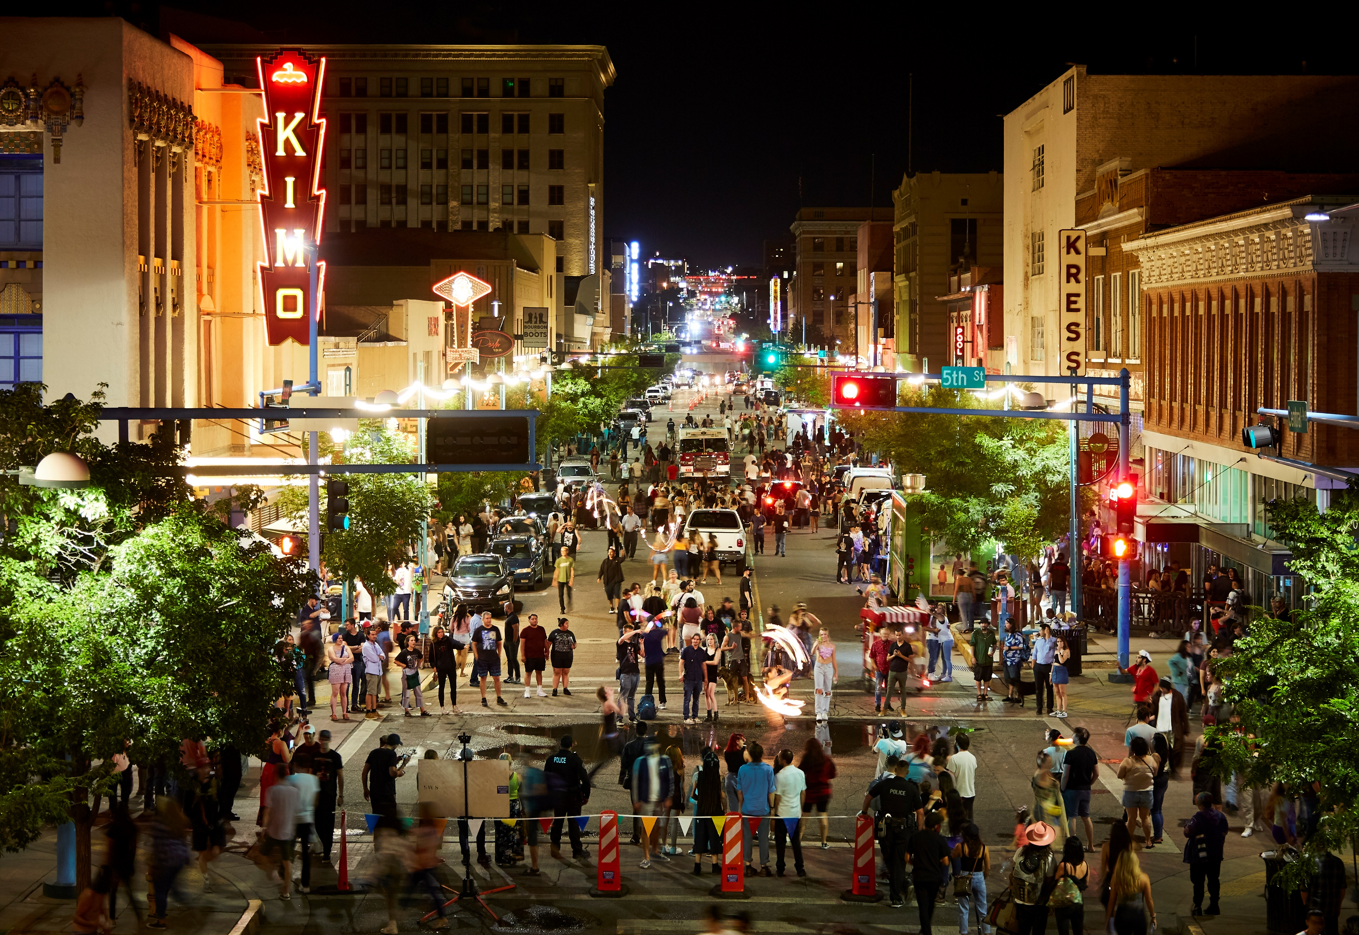
What is the Metropolitan Redevelopment Agency?
MISSION
Revitalize downtown and the Central Avenue corridor, leading collaborative public-private partnerships that result in catalytic change, investing in sustainable infrastructure, and providing opportunities for local residents and businesses to thrive

Slide 4
MRA Areas with Approved Plans
Notes:
**Show how to look up**

Slide 5
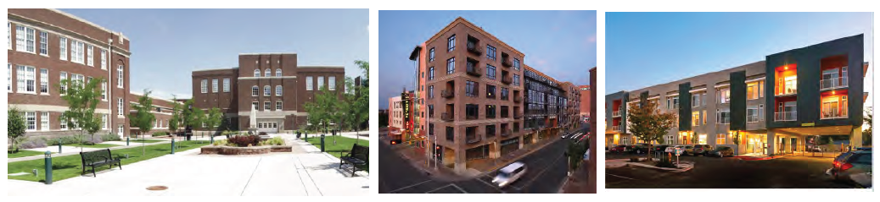
MRA Impact

Slide 6
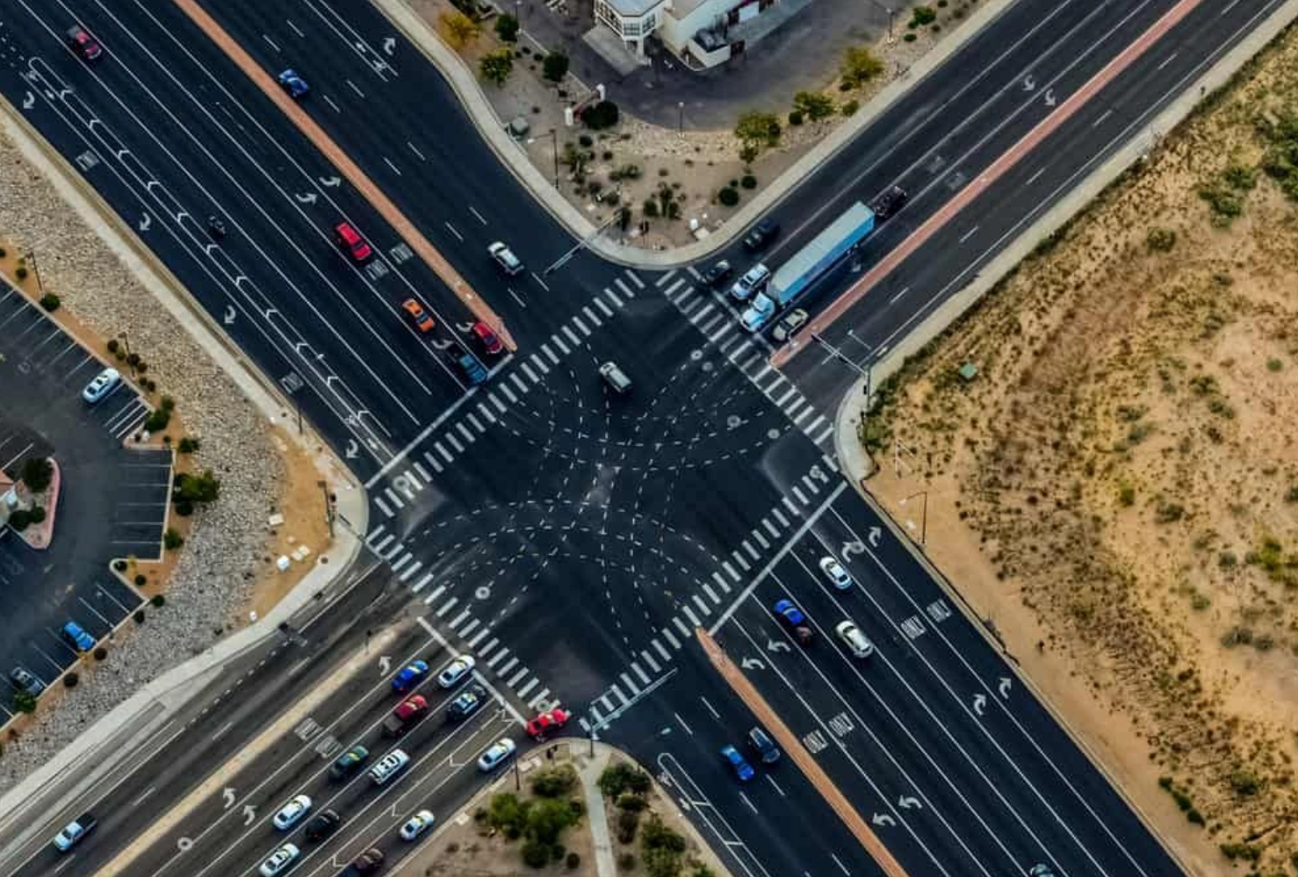
Impact Fee Waivers
Applies to any project in a metropolitan redevelopment area
Waiver is automatic
City will waive parks, street, open space, trails, police, fire, and drainage impact fees
Does NOT waive sewer, water, building plan review or building permit fees
Approximate value $1,500/ multi-family unit

Slide 7
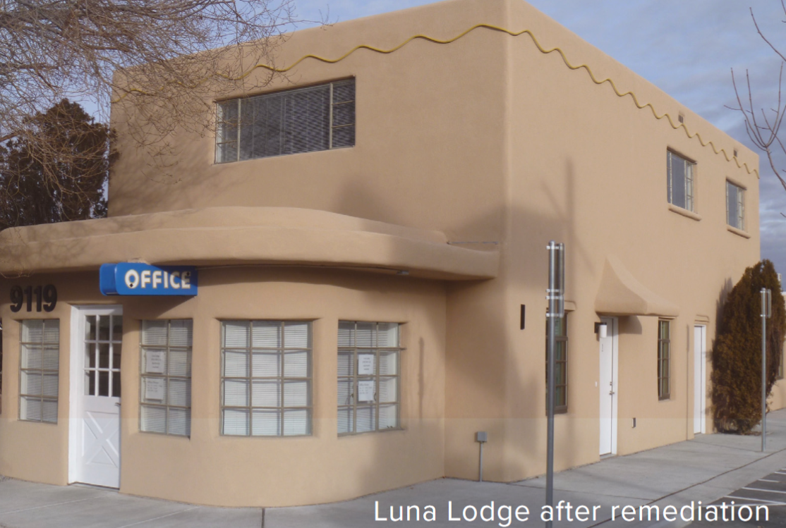
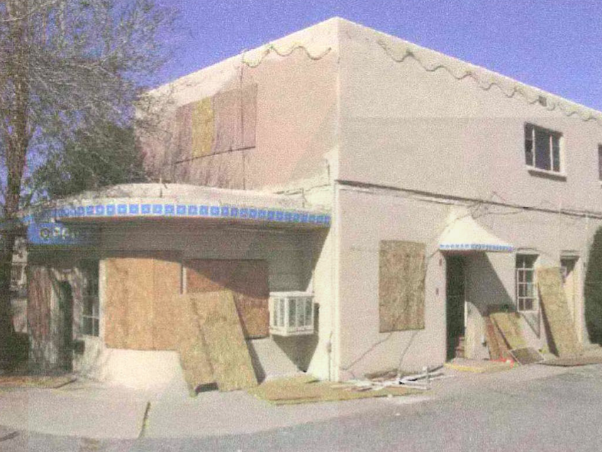
Brownfield Remediation Loans
Revolving Loan from EPA
$450,000 available
At least 2% Interest Rate
Repayment terms are flexible, but can not exceed 10 years
Must have completed a Phase 1 within 180 days AND prior to assuming ownership
Project must include an end use; stabilization does not qualify
Must have site control- deed, lease or option
Notes:
To encourage the redevelopment of contaminated properties in our community and promote infill and revitalization
Eligible Contaminants: Petroleum, lead based paint, asbestos, pigeon poo, any hazardous substance under CERLA
Common Sites; Gas Station, Dry Cleaners, Illegal Dumps, Drug Labs

Slide 8
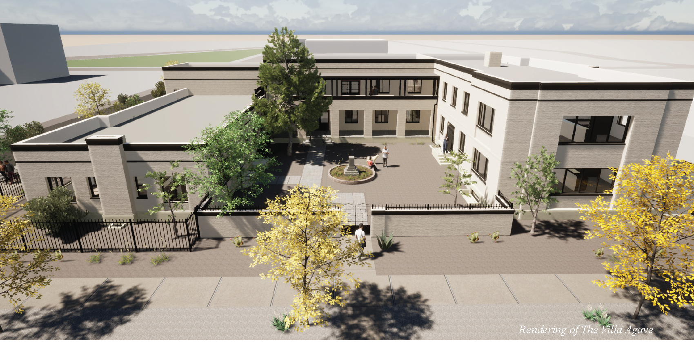
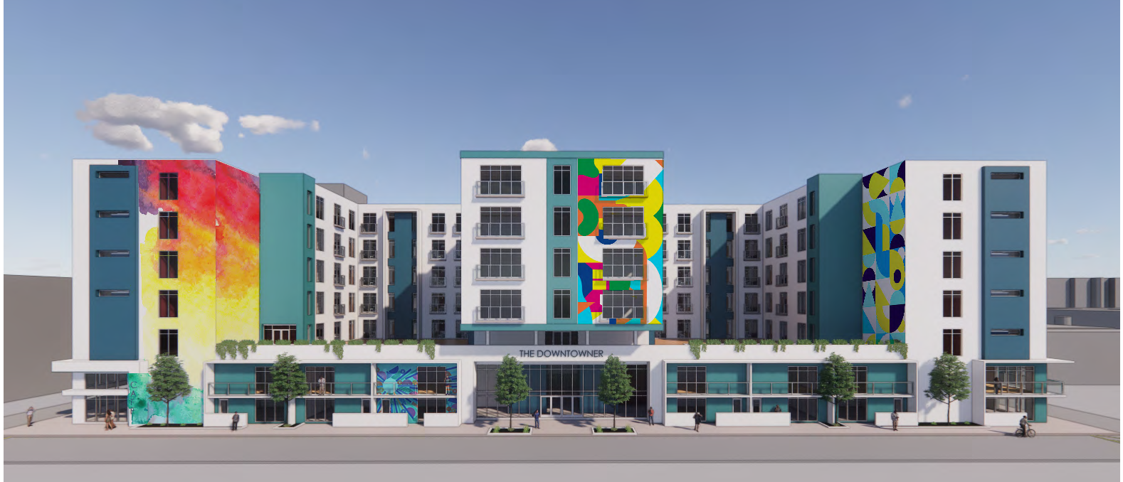
Redevelopment Tax Abatement Overview
Abates incremental property taxes for 7-years
Abates all jurisdictions taxes
Taxes before development must continue to be paid (PILOT)
City takes ownership of property and leases back to developer/owner
City subordinates to lender
Approximate value $8,000- $11,000 per unit

Slide 9
Redevelopment Tax Abatement Criteria
Must meet threshold criteria
Located in a metropolitan redevelopment area
Site Control- Deed, lease, or option
Minimum project size (must meet one)
  Hard construction cost $2M
  Minimum 8 new units
  15,000 sq. ft. commercial space
Minimum community benefit score of 100
Must meet evaluation criteria
Redevelopment Goals
  Eliminating of blighted conditions
  Meets MRA plan goals
  Demolition of viable buildings avoided
  Relocation of businesses/residents avoided
Buildings must be aesthetically pleasing with variation in color, texture, and scale.
Applicant experience with similar projects

Slide 10
Redevelopment Tax Abatement Process
Process
Pre- application meeting
Review MRA Plan goals
Submit complete application
Hearing by Albuquerque Development Commission
Final Decision by City Council
Execute Lease Document and Transfer Title
Timing Considerations
Plan on 5 months from application to final approval by City Council
Project must be approved by City Council prior to submitting for building permit
Must execute lease within 3 years of Council approval
Must be under construction or complete to execute project documents
 | Total Project Cost is Less than $6M | Total Project Cost is $6M or More
RTA Application Fee- Due when the application is submitted | $2,000 | $3,500
RTA Processing Fee- Due when lease is executed | $1,000 | $2,500
Annual RTA Abatement Fee | 10% of abatement value | 10% of abatement value

Slide 11
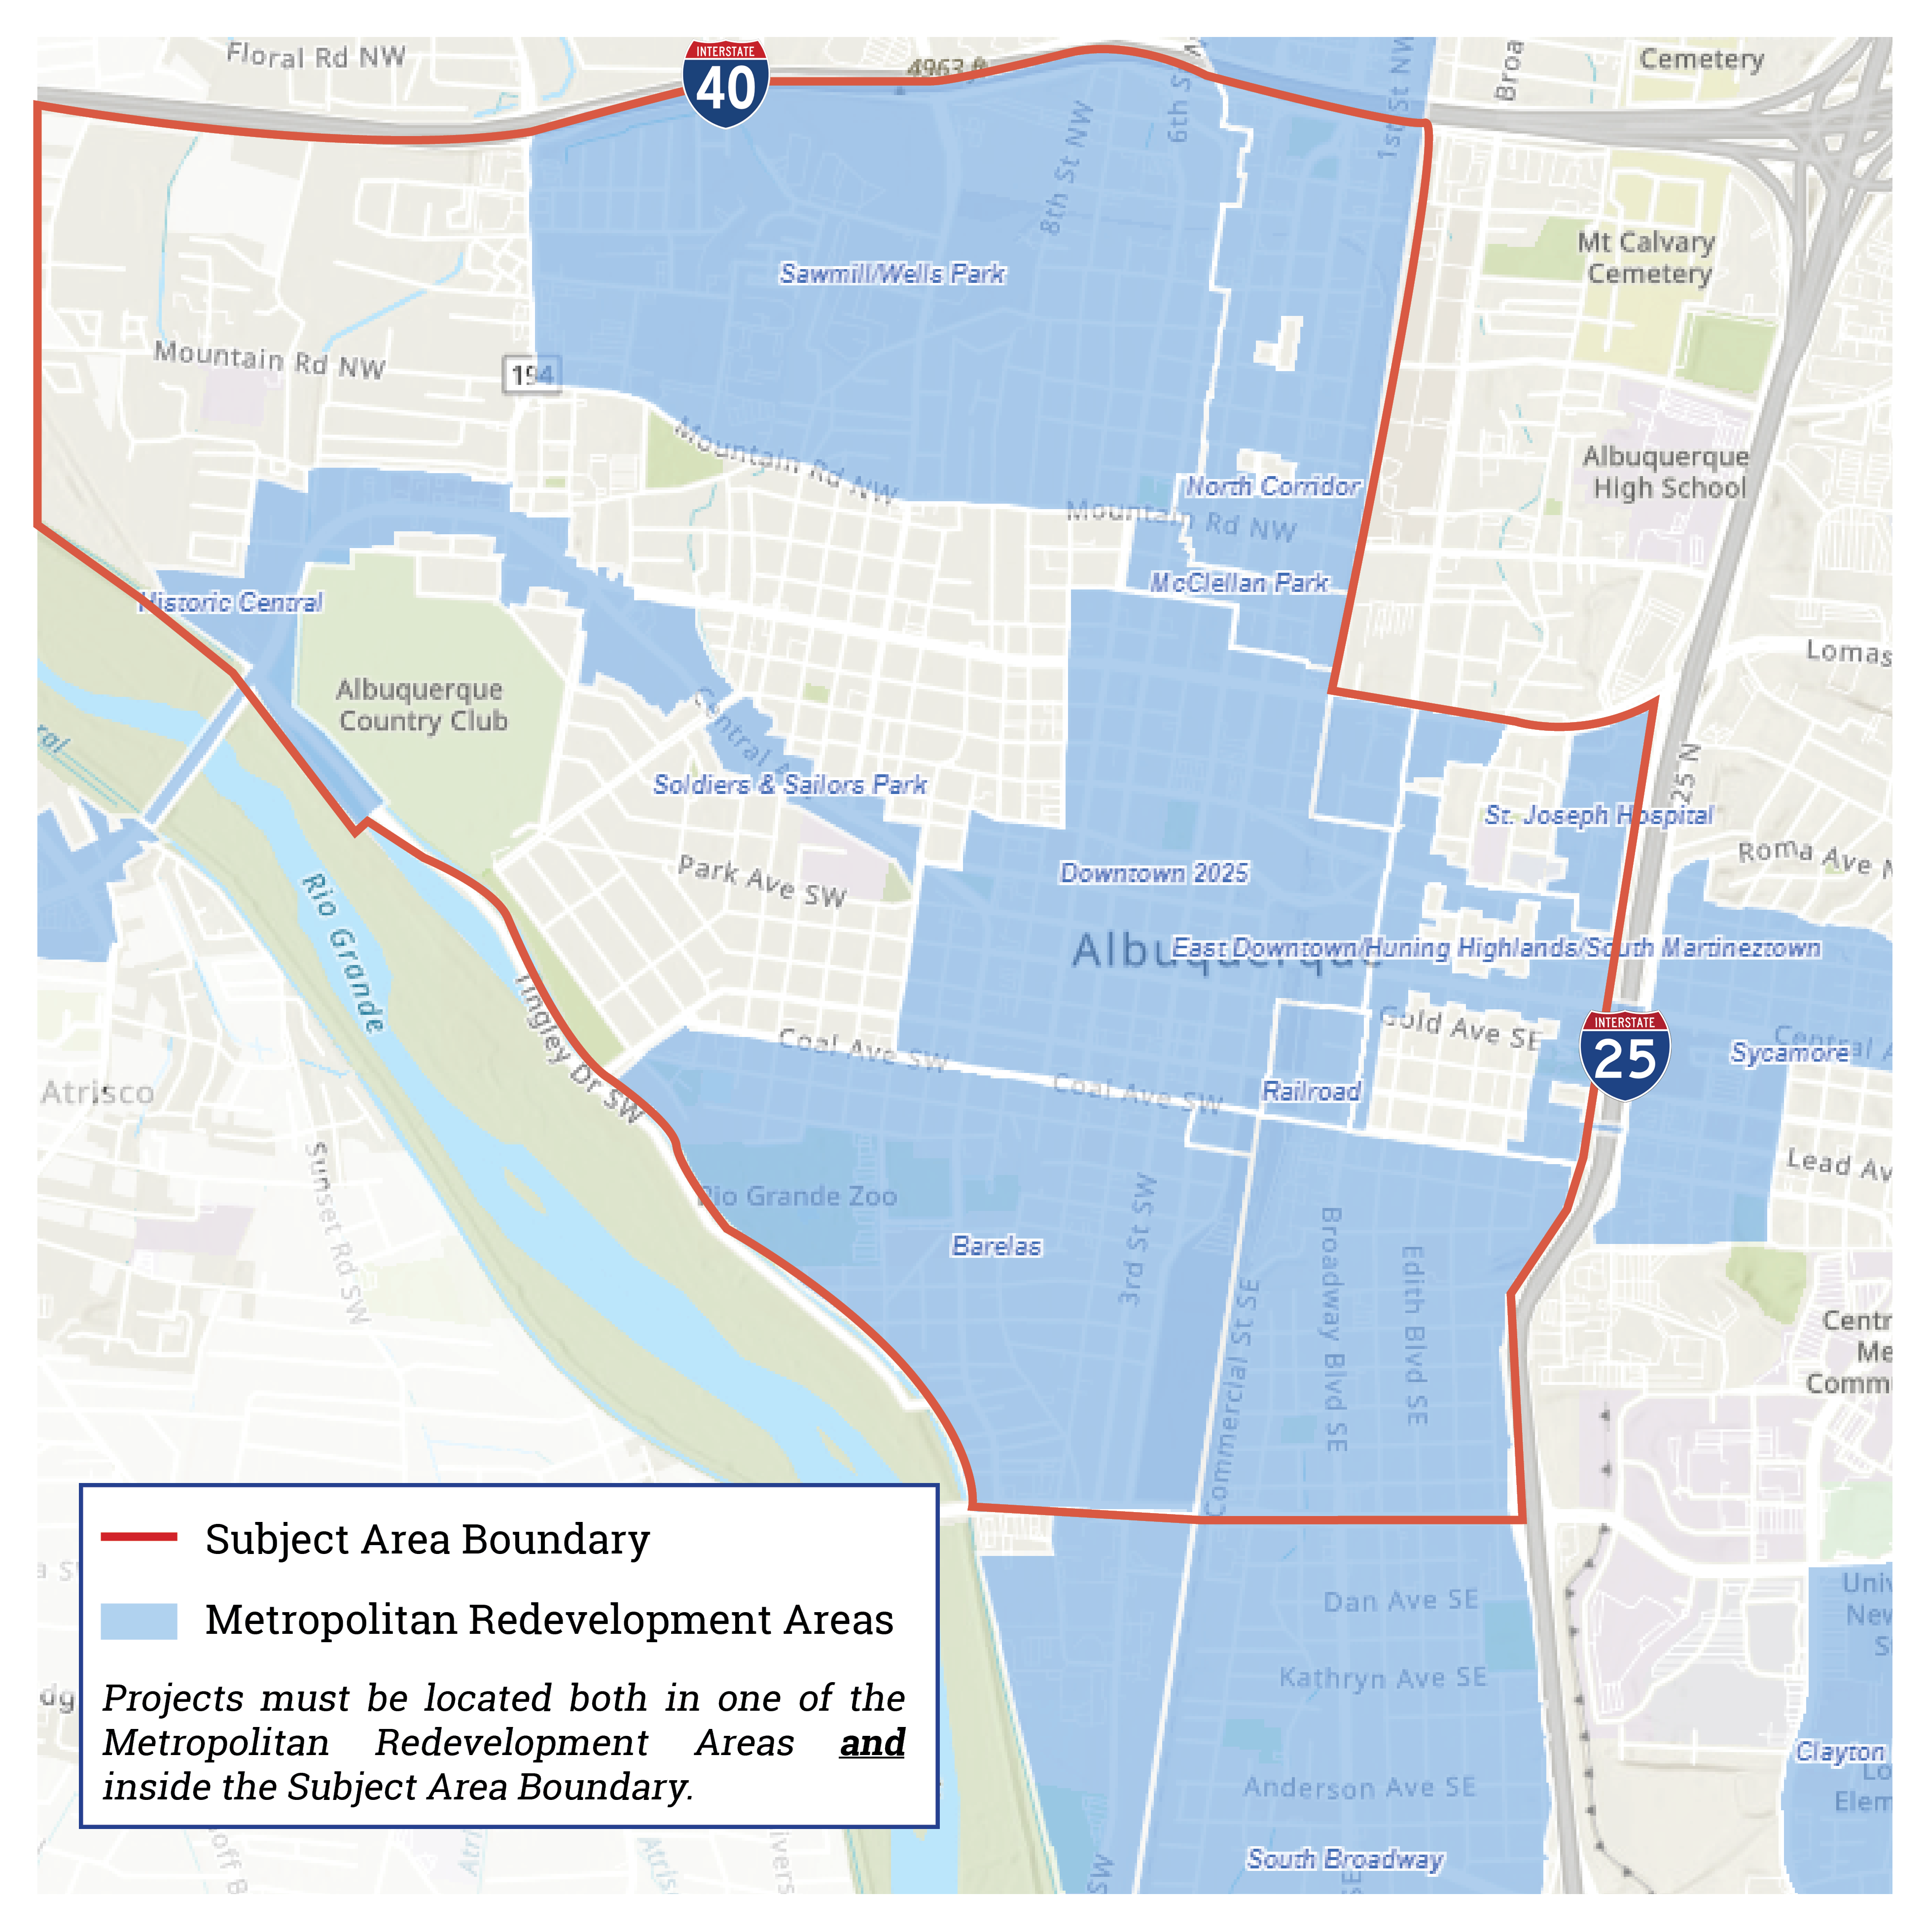
MRA Competitive Grants/Loans
Third round of funding launched last week- $3M
Highlights of 2022 Round
  Projects must add 50 units of housing
  Must have site control
  City does not fund pre-development expenses, contribute funding at closing or later
  City will finance no more than 20% of total development costs
  Structure- loan, equity, grant- is negotiable
  Can be stacked with Redevelopment Tax Abatement
  75 points on community benefit matrix
  Pre-proposal meeting November 30th

Slide 12
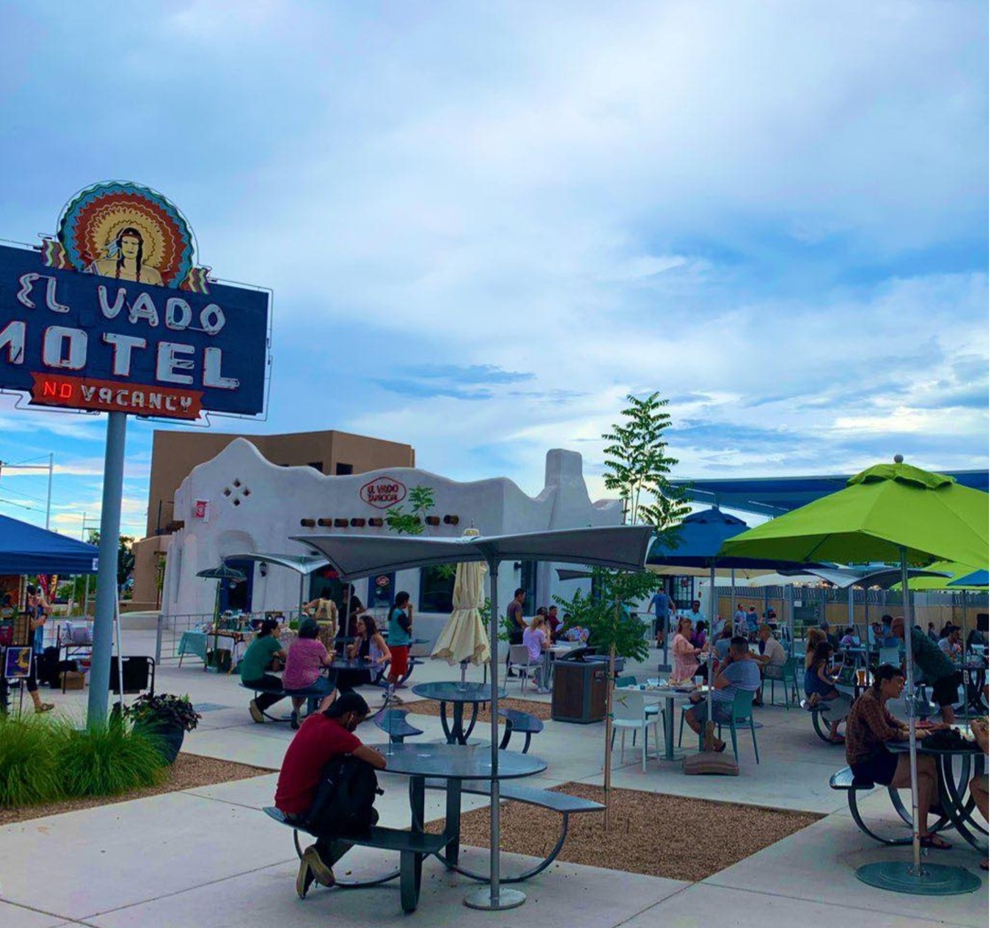
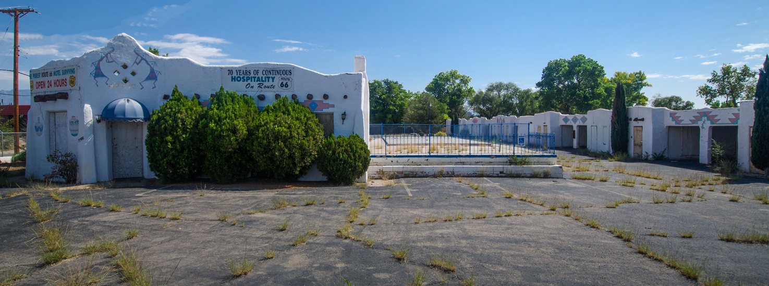
Request for Proposal for MRA Controlled Land
MRA can acquire land and reposition for development
RFP for development proposal that meet the metropolitan redevelopment plan
Price is negotiable and based on “Fair Value”
  Not market value
  Considers economic context
MRA currently has very limited land supply
Notes:
In determining the fair value of real property for uses in accordance with the metropolitan redevelopment plan, a local government
shall take into account and give consideration to the uses provided in the plan, the restrictions upon and the covenants, conditions and obligations assumed by the purchaser or lessee or by the
local government retaining the property and the objectives of the plan for the prevention of and recurrence of slum or blighted areas.

Slide 13
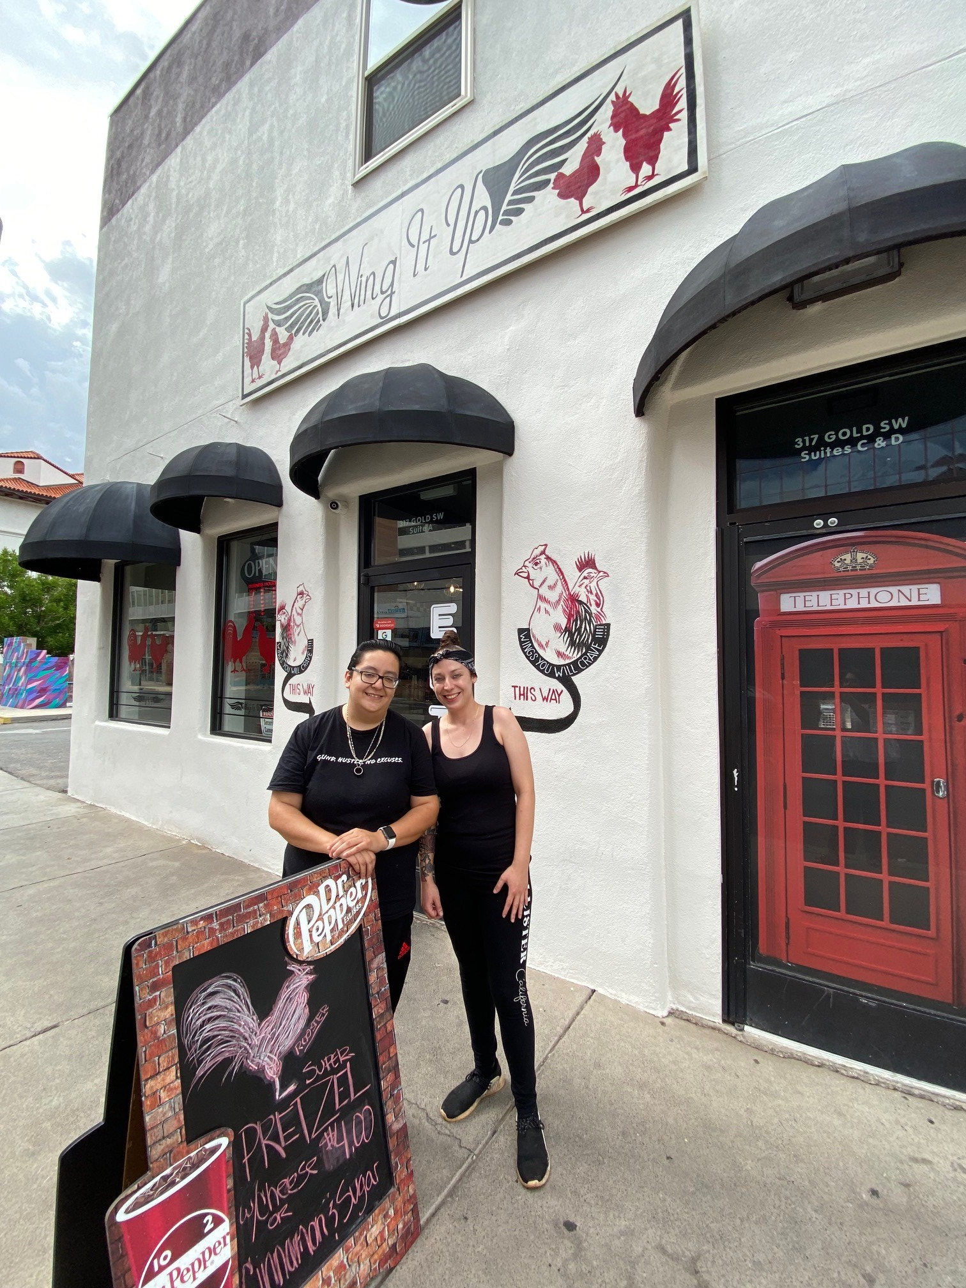
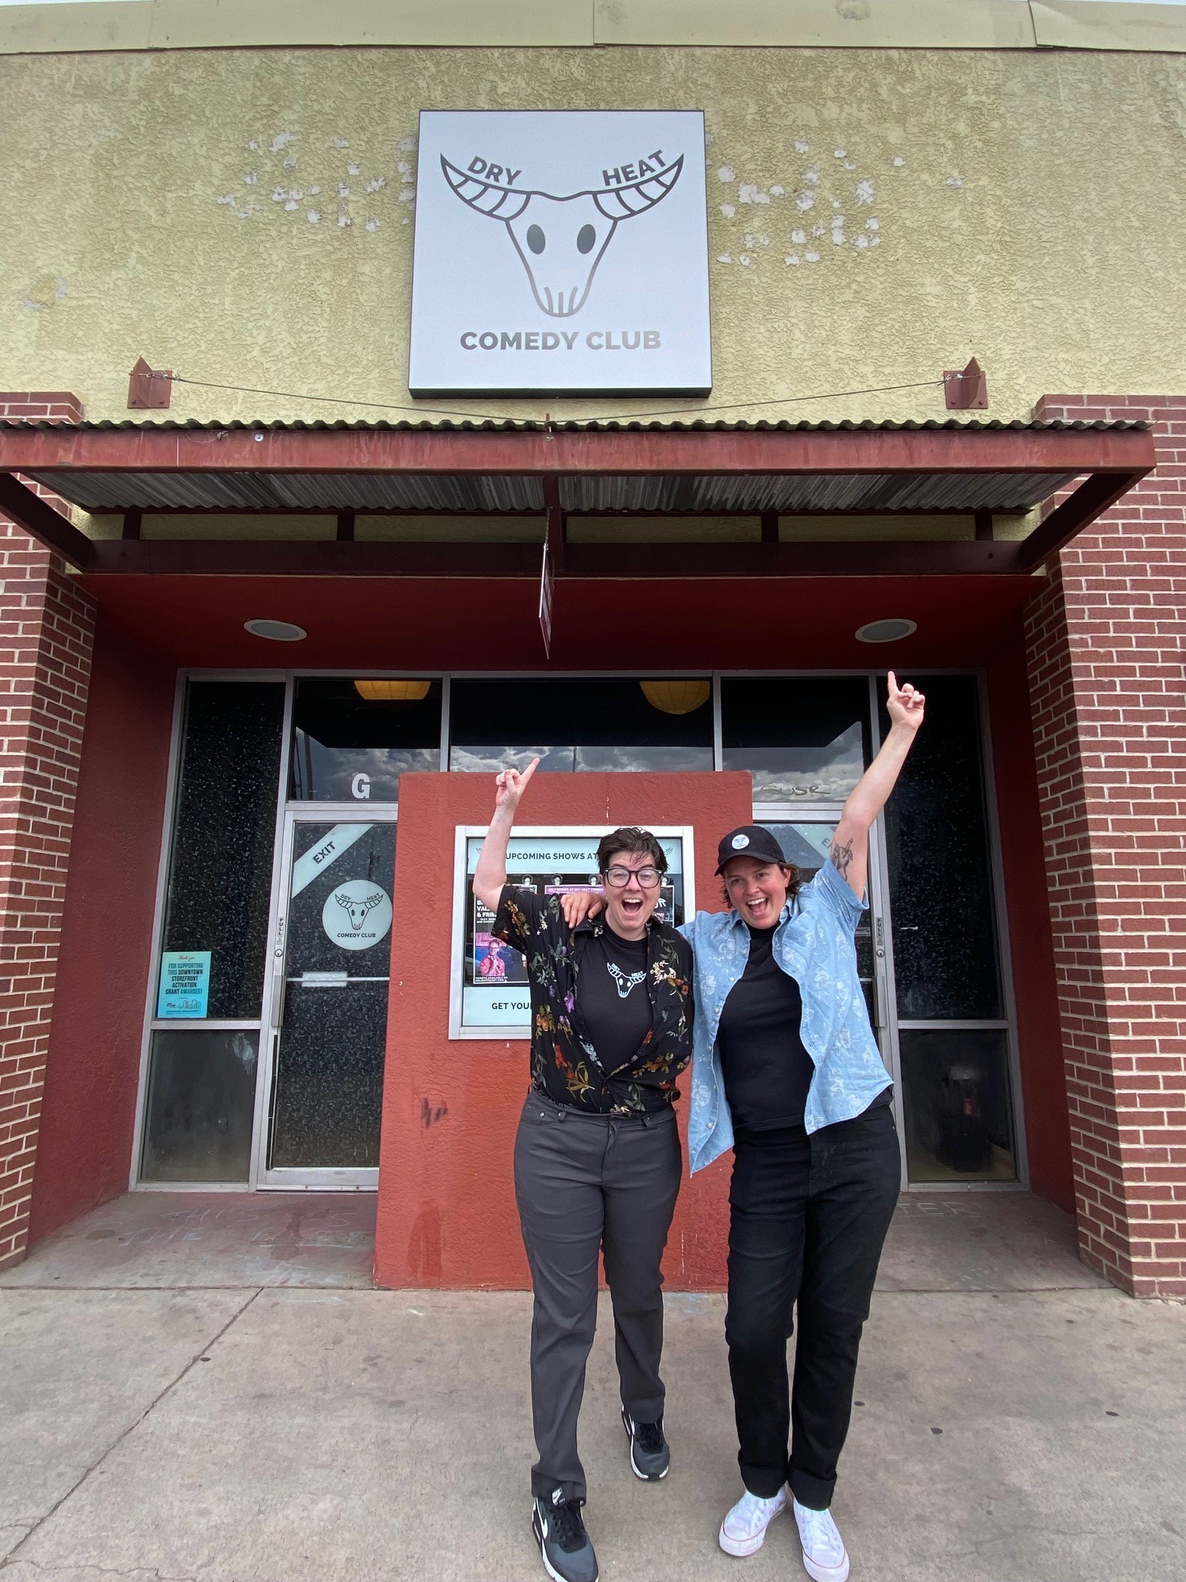
Storefront Grants
2021: Awarded $500,000 to 15 business, absorbing 40,000 sq. ft.
Round 2 now open $750,000 available
Downtown MRA only
Must be storefront space
Larger amounts $50,000- $250,000
Tenant applies
Must occupy larger spaces- at least 2,000 sq. ft.
Businesses must be established
Scope must include some renovation
Property database on MRA website

Slide 14
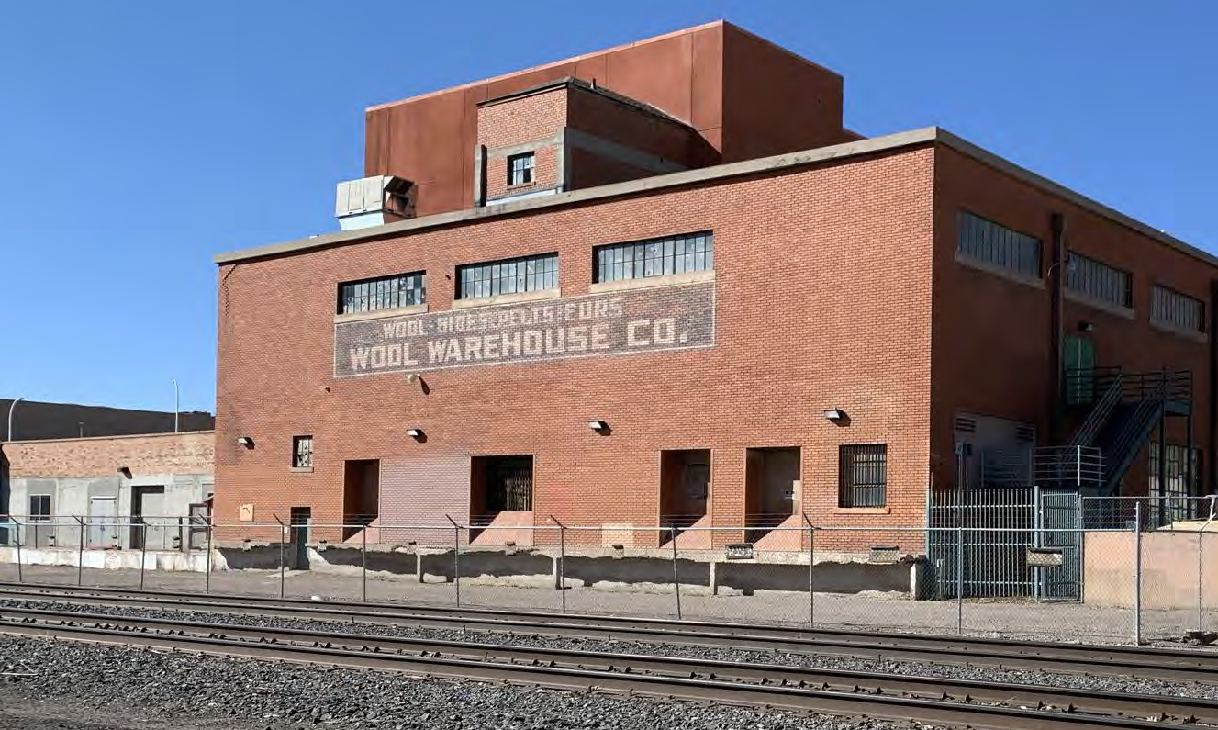
Albuquerque Rail Trail

Slide 15
Helpful websites
City GIS Mapping
Bernalillo County Property Assessor
Metropolitan Redevelopment Agency
  Sign up for our newsletter
Commercial Association of Realtors New Mexico Property Search

Slide 16
Contact Us
Todd Clark, CCIM
New Mexico Apartment Advisors
tclarke@nmapartment.com
Dean Kadell
Assistant Building Safety Manger
Planning Department, City of Albuquerque
dkadell@cabq.gov
505-924-3931
Karen Iverson
Metropolitan Redevelopment Agency Manager
City of Albuquerque
kiverson@cabq.gov
505-924-3814

