Slide 1
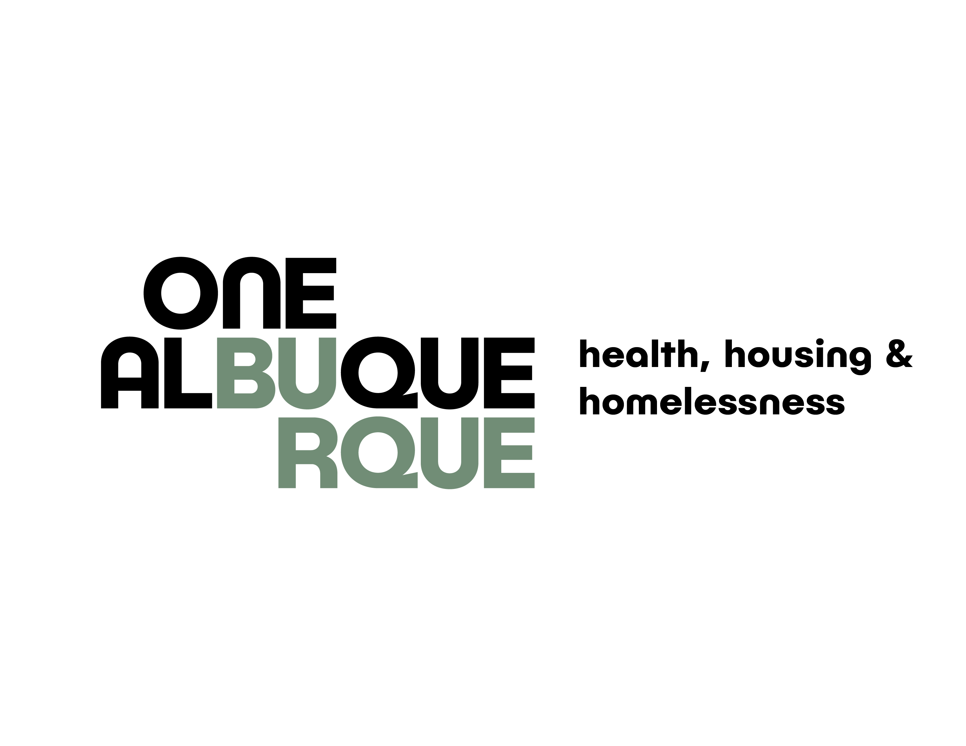
Transformative Neighborhood Planning Meeting
Bernalillo County, CARES Campus
CABQ, Gateway Medical Respite & Medical Sobering
Questions & Comments from Neighbors
HEALTH, HOUSING & HOMELESSNESS | 12.14.2023
Notes:
Presentation Opener Slide

Slide 2

Purpose
Learn about Bernalillo County CARES Campus
Learn updates on Gateway Medical Respite & Medical Sobering
HEALTH, HOUSING & HOMELESSNESS | 12.14.2023
Notes:
Basic Layout (right)

Slide 3
Principles for Success
Be hard on the issues, easy on the people
Listen to learn – seek to understand
Respect the speaker, respect the listener
Stay on topic to respect agenda and time constraints
Be kind and let’s have some fun too
Include time-line with action items
HEALTH, HOUSING & HOMELESSNESS | 12.14.2023
Notes:
Basic Layout (right)

Slide 4
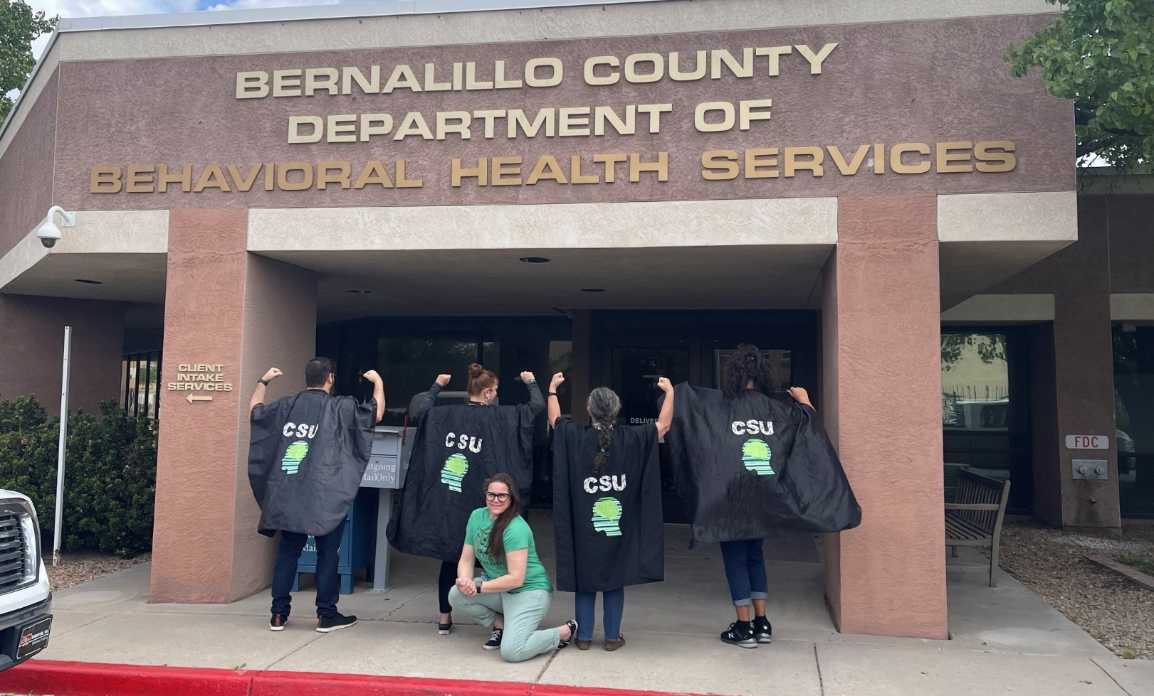
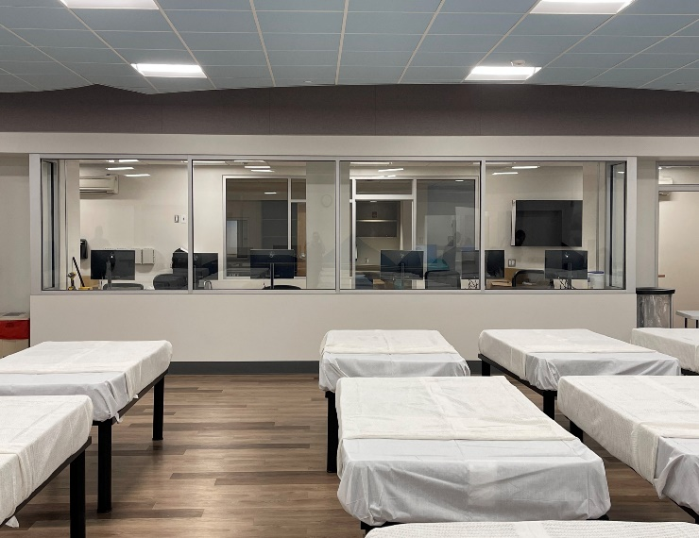
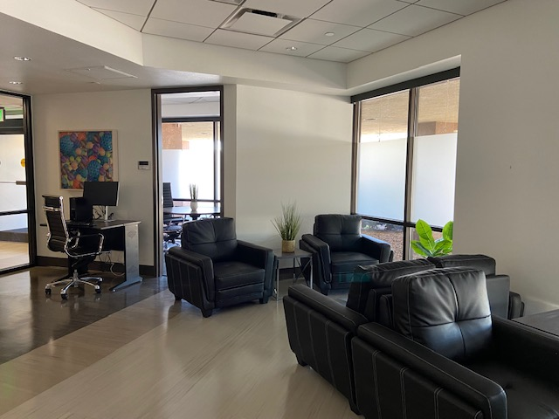
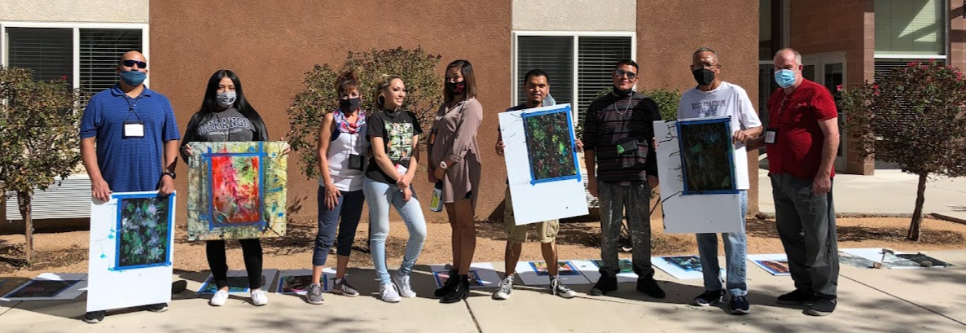
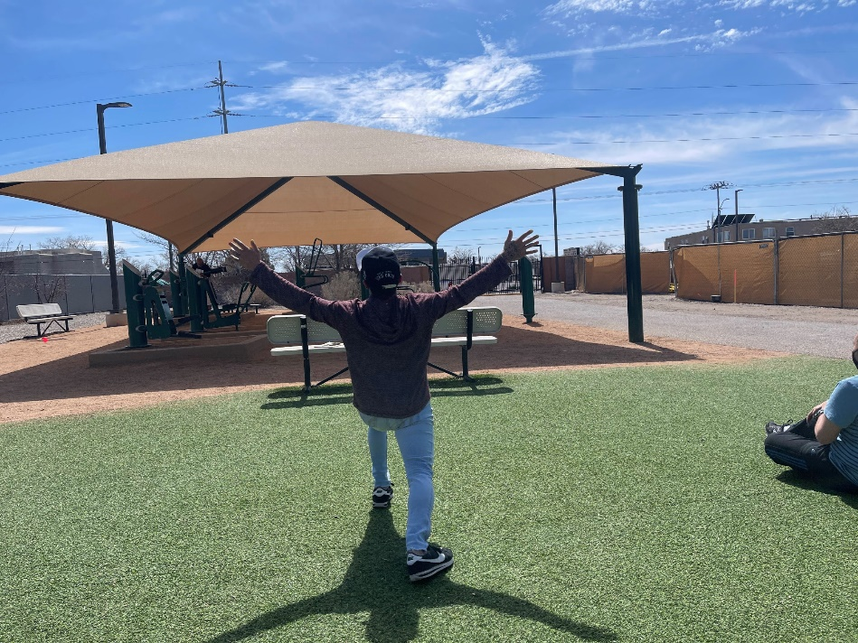
Department of Behavioral Health Services (DBHS): Care Campus
The Comprehensive Assessment and Recovery through Excellence (CARE) Campus provides direct care support services to reduce the impact of alcoholism, alcohol use, drug dependence, drug use, and mental health conditions within the community.
Social Model Detox
Supportive After Care
Crisis Stabilization Unit
Addiction Treatment Program (ATP)
Living Room Program
Outpatient Clinic
Observation & Assessment
Milagro Program
Young Adult Program (YAP)
DBHS Home - Behavior Health Services (bernco.gov) or call (505) 934-6430 for more information

Slide 5

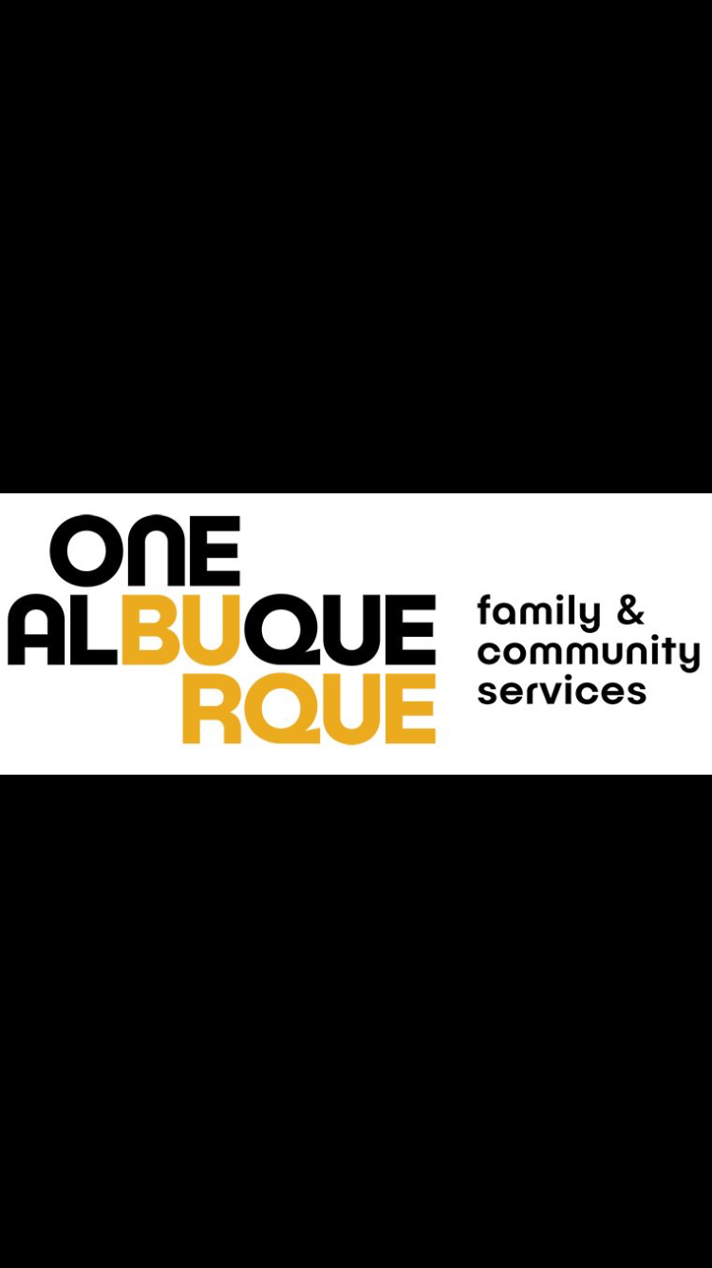
Medical Sobering Center
Presenters:
Gilbert Ramirez, MSW, LCSW, LSSW (He, Him, El)
Deputy Director of Behavioral Health & Wellness Programs
Department of Health, Housing & Homelessness
Ellen Braden, (She, Her)
Public Health Initiatives Manager
Department of Health, Housing & Homelessness

Slide 6


System Gap Analysis: master_final_gap-analysis_bernco_coa_071521.pdf (cabq.gov)
The City of Albuquerque/Bernalillo County System Gap Analysis (Published June 2021) highlights that “The success of the Community Safety Department, LEAD, and Community Outreach Teams will be contingent on the immediate availability and capacity for customers to receive services.” (p.55). The report also notes that Sobering Centers provide compassionate care to underserved individuals affected by substance use through early intervention and community care coordination to help them achieve lifelong recovery. The Sobering Center can provide a safe environment that serves an immediate need for individuals under the influence. As an alternative to jail and emergency room admissions, sobering centers are an appropriate destination to screen for and manage substance use disorders that present a public safety and health hazard.

Slide 7
Feasibility Study: Sobering Center Feasibility Study.pdf (cabq.gov)
The Sobering Center Feasibility study was prepared by the Family and Community Services Department (FCSD) at the request of City Council to determine the feasibility of a Sobering Center placed at the newly acquired Gibson Health Hub (GHH). The report was completed on August 2021. This study provides analysis of the current situation, including incidence data; research on best practices; cost considerations; facility size, personnel and staffing ratios; funding sources; community linkages; and proposed recommendations. The GHH Sobering Center is intended to divert individuals with intoxication from overcrowded emergency departments and jail to a safe place with medical monitoring to gain sobriety and access links to treatment, housing and other unmet social needs. Currently, Albuquerque has no such facility or resource.

Slide 8
Data:
Through 2018 to 2020, AFR responded to 43,094 substance-related intoxication and overdose incidents, at an average cost of more than $1.3 million per year. During the same three-year time period, the life-saving overdose reversal drug Naloxone was administered 2,007 times, with the highest rate administered in 2020 at 737 incidents. In fact, despite an overall reduction in response calls due to COVID-19 in 2020, data reveals that responses to unknown/unconscious and overdose 9-1-1 calls continued to increase. Adding to the overwhelming response rates are repeat 9-1-1 callers, in some cases as many as 10 times or more in a year. Over the past three years, 601 unique patients account for 9,858 incidents across all emergency 9-1-1 responses.
Regarding transports to a hospital, Albuquerque Ambulance (AA) transported over 30,000 intoxicated, overdosed or unconscious/unknown classified individuals to an emergency room following a dispatched call. The study found that nearly three quarters of all AA transports were taken to destinations within Albuquerque’s two largest hospital systems, with more than 40 percent taken to Presbyterian Hospital System (PHS), followed by nearly 30 percent to University of New Mexico Hospital (UNMH) emergency departments (EDs). In examining total SUD encounters at both hospital EDs over the past three years, UNMH had a higher SUD-related encounter rate at 32,788, with PHS at 21,668.
City of Albuquerque
Health, Housing & Homelessness

Slide 9
Target Population:
It is anticipated the Albuquerque Sobering Center will serve some of the City’s/County’s most fragile and underserved residents and will address the immediate clinical needs of persons experiencing moderate to severe intoxication in a safe, lower cost site while also meeting the broader needs of the clients it serves by creating access to case management, treatment and social resources. Participation is voluntary, and patients are free to leave at any time, with a minimum average stay of 3 to 4 hours and up to 24 hours when needed. It is proposed the site initially accept adults 18 years and older who are transported by emergency vehicles as a result of a 9-1-1 emergency response.

Slide 10
Outcomes of Interest:
• Provide better care for homeless alcohol-dependent persons to improve health outcomes.
• Decrease the number of inappropriate ambulance trips to the ED for homeless alcohol-dependent individuals.
• Decrease the number of inappropriate ED visits for homeless alcohol-dependent individuals.
• Create an alternative to booking individuals arrested for public inebriation.
• Persons with public intoxication/DWI safely recover in the least restrictive environment.
• Establish a front-door access to services, including housing and treatment.
• Create partnerships and collaboration with community resources.
• Meet or exceed client engagement goals to treatment and community resource referrals.
• Reductions in use of emergency services including emergency response and hospitalization.
• Reductions in contacts with the criminal justice system.
• Increased use of preventative medical and behavioral health services.
• Reductions in mortality from untreated illness and environmental exposure.
• Increase in indicators of social stability.
• Improved quality of life.

Slide 11
Implementation
A 3-phased approach to implementation of the Albuquerque Sobering Center is recommended to facilitate startup and guide expansion of capacity and services for the City’s most vulnerable population. The City plans to expedite implementation of Phase 1, using one or more outsourced vendors and leveraging this funding request and other funding sources to staff the center with an administrative and clinical team and to prepare the facility for an initial 20-bed operation.
It is proposed the clinical staff be outsourced with one or more contracts managed by Family and Community Services and that protocols for transports and medical care be coordinated through AFR EMS. Phase 1: The proposed short-term stay (less than 24 hours) Sobering Center is an alternative destination that has potential to be quickly implemented at the Gibson Health Hub and former site of the Lovelace Hospital emergency department. At startup, it is recommended the Sobering Center be a 24/7 20-bed operation with a registered nurse and paramedic monitoring onsite. Clinical direction would be overseen by a medical director. Ideally, the medical director would be housed full-time onsite, trained in addiction medicine and have some emergency experience. Completing the clinical care team are certified peer recovery specialists and case

Slide 12
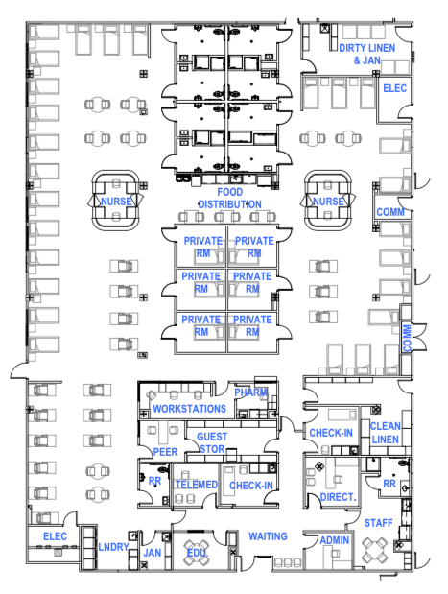
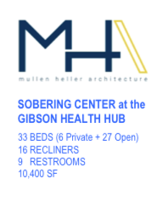
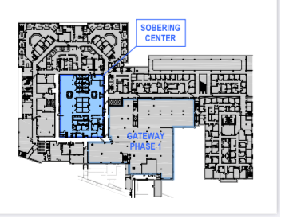
Medical Sobering
Divert individuals with low to moderate acuity intoxication from overcrowded emergency departments and jail to a safe place to gain sobriety
Staffed with registered nurses or emergency medical technicians with triage and monitor until sobriety is achieved;
Voluntary participation with an average stay of 3 to 4 hours and up to 24 hours;
Possible Medicaid reimbursements.
Medical Sobering Feasibility Study: https://www.cabq.gov/family/documents/sobering-center-feasibility-study.pdf

Slide 13

Building a continuum of care…
Service | Description | Outcome | Estimated Yearly Impact by 2005
Housing Navigation | Low, barrier, trauma-informed overnight beds for transition to housing | Successful exit to safe, stable housing and a plan for ongoing support | 1000 individuals
Engagement Center | Easy access to services needed for case management, job searching, and other supportive services | Supports needed for a successful exit to safe, stable housing | 1000 individuals
Receiving Area for first responders | Low-acuity, 24/7 connection point to shelter, housing, other services | Provide a non-medical place for ACS and First Responders to take people in need | 1,500 connections/ transports to needed services
Medical Sobering | Low-acuity, medical monitoring to gain sobriety; Complement to CARES Campus | Divert individuals from emergency departments and incarceration | 17,000+ overnight stays
Medical Respite | Overnight patient-centered medical care and necessary social services and supports. | Reduce avoidable emergency department usage and potential re-admissions; connect individuals to permanent supportive housing | 320 individuals

Slide 14
Building a continuum of care…
Gateway Shelter
low-barrier, trauma informed beds
50 men, 50 women, 25 families, couples
Engagement Center
Job training, case management, etc.
Medical Respite
Short - term medical residential care
Drop- Off
24/7 connection point to other services
Medical Sobering
Low-Moderate acuity substance sobering center
Trauma Recovery
Center
Connection to services for victims of violent crime
Other service provider locations (Other shelters, hospitals, CARE Campus, etc.)
Notes:
Cristina

Slide 15
Preliminary Budget:
Following is an estimated summary of startup and Phase 1 implementation cost considerations for
placement of the proposed City-managed Albuquerque Sobering Center at the Gibson Health Hub and site of the proposed Gateway emergency homeless shelter. Facility build-out costs are estimated. Use of the designated space at the former Lovelace Hospital emergency department may prove beneficial in minimizing build-out costs and expediting a Phase 1 opening.
Phase 1 startup costs, including capital facility costs and first year operating costs for the Medical Sobering Center are estimated to require $8,701,600.

Slide 16
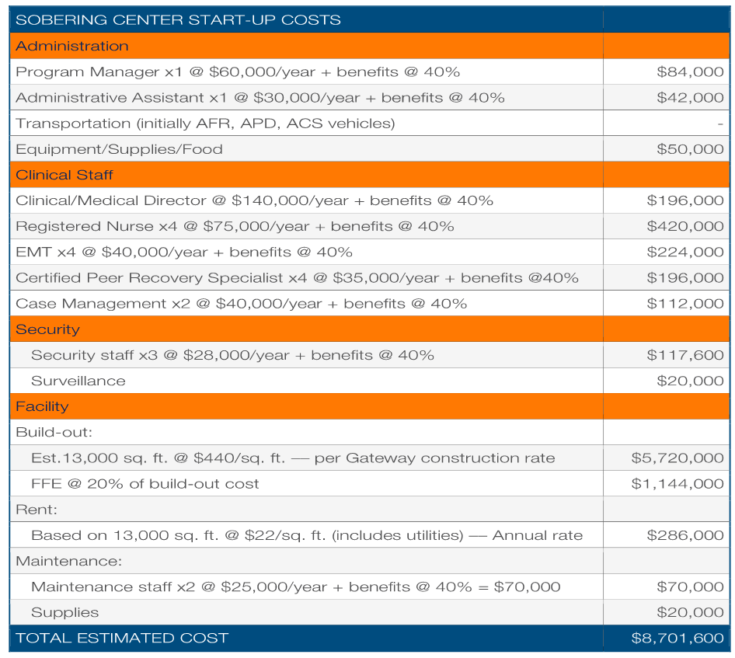
City Council approved $730,000 in recurring support of medical sobering operational costs in the FY23 budget. The FY/24 budget also included $500K to support the operations of the opening year.

Slide 17

Funding Resources
The medical sobering center has received significant financial support from many partners totaling $8.75 million
Bernalillo County: The Bernalillo County Board of Commissioners approved $4.35 million in Behavioral Health Initiative funding to support the City of Albuquerque’s Medical Sobering Center to be located at the new Gibson Health Hub.
Senator Heinrich and Representative Stansbury secured the funding in the Omnibus Appropriations Agreement for Fiscal Year 2023 (FY23).
*$2 million in congressionally directed spending for the City of Albuquerque to help develop programming for the Albuquerque Medical Sobering Center in New Mexico. Additionally, this funding will be used for operational costs including the hiring of professional and certified medical staff, program management and administration, supplies, transportation vehicles, and facilities management.
*$2.2 million in congressionally directed spending for construction, renovation, and equipment costs for the Albuquerque Medical Sobering Center.
Capital Outlay Projects Approved by NM Governor 2023 – SB192 - $200,000 For a pilot project at the Albuquerque Gateway center for medical sobering addiction treatment services as an alternative to jail or a hospital to allow persons who are intoxicated and nonviolent to recover from the effects of alcohol and drugs.
Lastly, City Council approved $730,000 in recurring and $500,000 in non-recurring funding for FY/24 for a partial year of operating a Medical Sobering Center at Gibson Health Hub.

Slide 18
Questions ?
Learn More at:
Medical Sobering — City of Albuquerque (cabq.gov)

Slide 19
Thank You!
Presenters:
Gilbert Ramirez, MSW, LCSW, LSSW (He, Him, El)
Deputy Director of Behavioral Health & Wellness Programs
Department of Health, Housing & Homelessness
E-mail: gramirez@cabq.gov
(505)768-2866
Ellen Braden, (She, Her)
Public Health Initiatives Manager
Department of Health, Housing & Homelessness
E-mail: ebraden@cabq.gov
(505)768-2788

Slide 20
Thank you!
HEALTH, HOUSING & HOMELESSNESS | 12.14.2023
Notes:
Basic Layout (right)

