Slide 1
Albuquerque Progress Report: 2017 Stakeholder Meetings
Chamber of Commerce, City Economic Development Dept. CNM, City Municipal Dept. (DMD), City Environment Dept., City Solid Waste Dept., City Fire Dept., United Way of Central New Mexico
Indicators Progress Commission
April 11, 2017

Slide 2
Albuquerque Progress Report: 2017 Stakeholder Meetings
Albuquerque Chamber of Commerce
Indicators Progress Commission
April 11, 2017

Slide 3
Meeting on March 14, 2017
IPC Members & Staff Present
Kendra Montanari
Frank Roth
Stakeholders Present
Tom Antram, Board Chairman
Notes:
3

Slide 4
Goal Relationship
Human & Family Development
Residents are literate, skilled and educated.
All students graduate from high school and are prepared for a career or post-secondary education.
Public Safety
Public is safe / Public feels safe
Community works together for safety.
Sustainable Community Development
Downtown area is vital, active, and accessible
Economic Vitality
Economy is vital, prosperous, sustainable, and strategic, based on local resources
Abundant, competitive employment opportunities
Notes:
4

Slide 5
Strategic Planning
Developed Strategic Plan in 2016 – Building a Stronger New Mexico Together
Good alignment between desired community conditions to ACC goals – 3 BIG Issues
Education (world class education)
Public Safety (every citizen feels safe)
Downtown Development (robust and thriving downtown)
Focus on these 3 issues will strengthen the economy, foster competition, and create more jobs
Determining metrics is the next step…
Notes:
5

Slide 6
Sector Advocacy
Sector Advocacy Teams
Financial and Financial Services
Tourism and Hospitality
Healthcare
Manufacturing
Professional Services
Entrepreneurs
Retail/Service
Developers/realtors/contractors
Work to develop recommendations for ACC’s advocacy efforts that will help these sectors grow and prosper
Monitor and advocate for those issues before local, county, and federal government
Notes:
6

Slide 7
Connection Advocacy Network
Advocate on behalf of and providing opportunities for the community
Guide ACC’s efforts toward cohesive messaging and branding
Develop a strong economic development communications plan for the ACC through publications, communications and social media
Track progress, provide scorecard on the 3 BIG issues
Notes:
7

Slide 8
Cities they Aspire Towards
Denver
Oklahoma
Fund created for downtown
Tax of 1 cent on the dollar
List of to do projects
Immune to leadership changes
Notes:
8

Slide 9
Feedback
APR is a great report
Aligns well with the Chamber goals
We should track hits and market the site
The report is an opportunity to highlight what we are doing right
Notes:
9

Slide 10
Albuquerque Progress Report: 2017 Stakeholder Meetings
Economic Vitality Goal
Economic Development
Frank and Kendra
Indicators Progress Commission
April 11, 2017

Slide 11
Meeting on March 14, 2017
IPC Members & Staff Present
Kendra Montanari
Frank Roth
Stakeholders Present
Gary Oppedahl, Director, City Economic Development
Notes:
11

Slide 12
Economic Vitality Goal
Goal Statement: The community supports a vital, diverse and sustainable economy.
Desired Community Conditions
The economy is diverse.
The economy is vital, prosperous, sustainable, and strategic based on local resources.
There are abundant and competitive career oriented employment opportunities.
Entrepreneurs and businesses of all sizes develop and prosper.
Albuquerque is a place where youth feel engaged and believe they can build a future.
Notes:
12

Slide 13
Meaningful Measures?
Good alignment of community conditions to department goals
DCCs & KPIs are meaningful, practical, measure what is being done at City Economic Development
Average Annual Growth in Per Capita Income ⬆
Per Capita Income
Annual Job Growth ⬆
Unemployment Rate MSA ⬇ (this one is misleading)
Employment in Government as % total ⬇
Notes:
13

Slide 14
Alignment with Department Goals
Small job growth
Hiring Milestones (1st, 5th, 10th, 20th, 50th)
Focus on job plans – Key Drivers
Safety corridor
Economic development
Transit
Equity
Notes:
14

Slide 15
Key Strategies/Programs
Innovation Central (innovationcentralabq.com)
Empowers individuals with ideas at all levels of society, regardless of education, background or interest
Collaborative and inclusive approach to economic development
Building under construction in downtown
Electric buses
First Pilot in nation
Less cost to taxpayers
CNM Coder school, 10-week bootcamp
Notes:
15

Slide 16
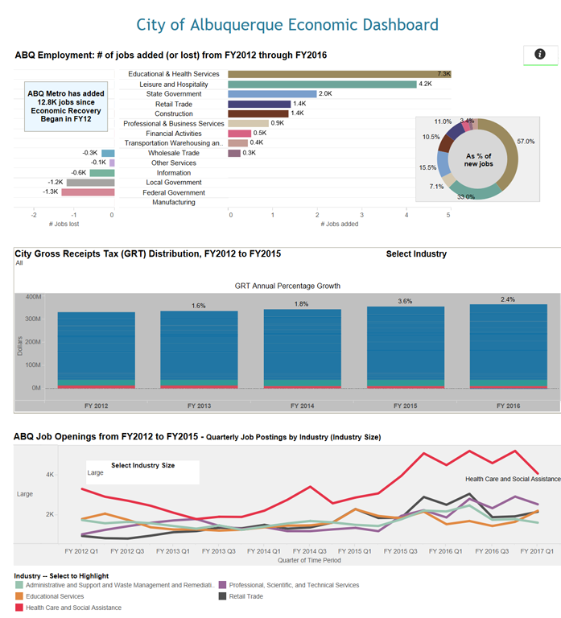
Key Strategies/Programs
www.cabq.gov/economic-dashboard
Monthly Economic Data
Monthly Employment Data
Annual Economic Data
Notes:
16

Slide 17
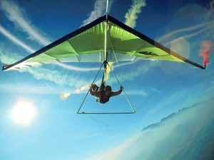
Recommendations
Link to ED Dashboard, publish twitter account
More Graphics, fewer words (Infographics)
Pocket materials, maps and reports
Marketing
Weather and extreme events
Housing prices
Commute times
Access to transit
Convene, Convince, Cajole…
Never Control
RIDE THE THERMALS!
Notes:
17

Slide 18
Albuquerque Progress Report: 2017 Stakeholder Meetings
CNM, Dawn
Human and Family Development Goal
Indicators Progress Commission
Mar 29, 2017

Slide 19
CNM: Human and Family Development Goal
Meeting on March 8, 2017
IPC Members & Staff Present
Dawn Reed
Stakeholders Present
Samantha Sengel, Chief Community Engagement Officer
Notes:
19

Slide 20
CNM: Human and Family Development Goal
Goal 3 DCC Integrated Transportation aligns with CNM goals
Free bus passes indicator

Slide 21
CNM: Human and Family Development Goal
Goal 4 is aligned to CNM goals
One third of funding comes from property taxes; overall business and population growth is good for CNM.
Amount of money collected in property taxes may be a good indicator for Goal 6.

Slide 22
CNM: Human and Family Development Goal
Goal 5 is also aligned and important to CNM.
They have built more LEED Silver buildings in NM than all others
Possible national data from the group that certifies LEED construction activities.
LEED construction permits or square footage may also be new indicator that could be found in the city permitting office

Slide 23
CNM: Human and Family Development Goal
Goal 6 is the area most strongly aligned to CNM mission.
CNM uses indicators such as available skilled workforce (from census or by each educational institution).
Available workforce attracts more companies and adds jobs
Population changes indicator.
While population is largely steady, indicators of birth and death rates, as well as what segments are leaving and what segments are coming in might be insightful to understanding the true picture of economic vitality.

Slide 24
CNM: Human and Family Development Goal
Goal 8 is not a concern to CNM per se
Samantha remarked that it is the only goal area that does not have any orange or purple data. In this era of fake news and conspiracy theories, it may seem disingenuous that the goal that covers the City’s performance is better than all the other goals.

Slide 25
CNM: Human and Family Development Goal
Potential IPC actions:
Find GED measures
Obtain CNM EI study report
Determine if ridership by CNM/UNM students is important
Determine if property tax infor would be useful
Follow up with city building permitting
Find LEED certifying organization and search to national benchmarks
Add other indicators to Goal 8 in 2018 report.

Slide 26
CNM: Human and Family Development Goal
DCC Educated, Literate, Skilled Residents aligns to CNM goals.
Suggest adding GED attainment as new indicator
Can provide EI study for other indicators and national data

Slide 27
Albuquerque Progress Report: 2017 Stakeholder Meetings
Public Streets & Storm Stakeholders
Public Infrastructure Goal
DMD, Frank
Indicators Progress Commission
April 11, 2017

Slide 28
Meeting on February 15, 2017
IPC Members & Staff Present
Frank Roth
Olivia Padilla-Jackson
Stakeholders Present
Melissa Lozoya, Director, City Municipal Development
Greg Smith, City Municipal Development
Keith Reed, City Municipal Development
Notes:
28

Slide 29
Public Infrastructure Goal
Goal Statement
The community is adequately and efficiently served with well planned, coordinated, and maintained infrastructure.
Desired Community Conditions
The storm water system protects lives, property, and the environment.
Integrated transportation options meet the public's needs.
The street system is well designed and maintained.
Sustainable energy sources are available.
Notes:
29

Slide 30
Meaningful Measures?
Commuter Travel Delay indicator decreased from 37 to 36 annual hours (down 2 hours since 2008)
Travel time delay is measured by the extra travel time during peak periods when compared to non-peak travel times
Data is from the 2015 Urban Mobility Scorecard maintained by Texas A&M Transportation Institute
Public Transportation Riders indicator significantly improved
Paseo del Norte/I-25 interchange may have helped too
Notes:
30

Slide 31
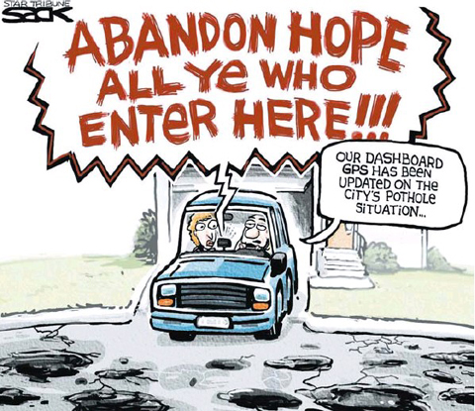
Key Strategies/Programs
Need to include Pavement Condition Index in next APR
Implementing new municipal separate storm sewer systems (MS4) permit is major issue for development community
Opportunities for collaboration/ coordination with AMAFCA
Notes:
31

Slide 32
Albuquerque Progress Report: 2017 Stakeholder Meetings
Environmental Protection Goal Stakeholders
Solid Waste Dept., Frank
Indicators Progress Commission
April 11, 2017

Slide 33
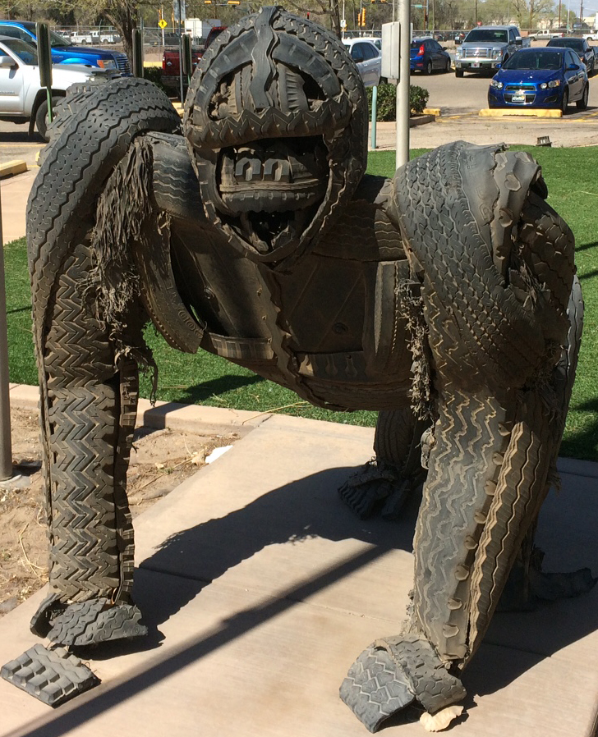
Meeting on March 20, 2017
IPC Members & Staff Present
Frank Roth
Stakeholders Present
John Soladay, Director
Jill Holbert, Deputy Director
Solid Waste Management Dept
Notes:
33

Slide 34
Environmental Protection Goal
Goal Statement
Protect Albuquerque's natural environments - its mountains, river, bosque, volcanos, arroyos, air, and water.
Desired Community Conditions
Solid wastes are managed to promote waste reduction, recycling, litter abatement, and environmentally-responsible disposal.
Residents participate and are educated in protecting the environment and sustaining energy and natural resources.
Notes:
34

Slide 35
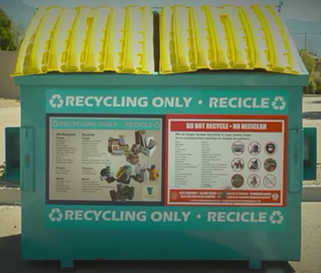
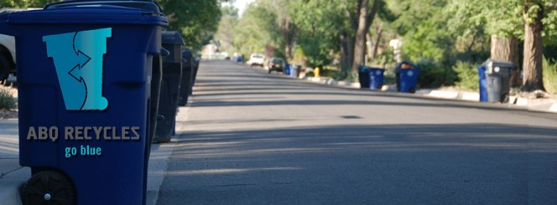
Meaningful Measures?
Residential recycling increased from 18% to 19.5%
500 commercial accounts
20 recycling drop-off centers
Peer city ranking is 2nd of 3
Total pounds landfilled per person per day increased 4.8 to 5.0
Peer city ranking is not measured
Both measures are Undesirable but Improving
Notes:
35

Slide 36
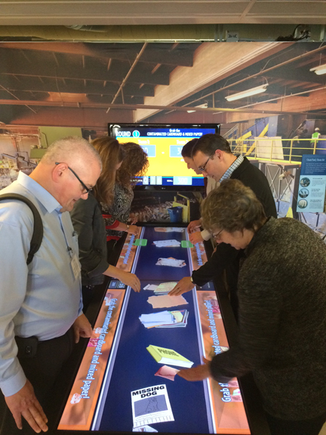
Alignment with Department Goals
More attention needed for education and outreach
Cost of services study completed, rate adjustments needed or changes to fee structure
Addressing aging assets – facilities and equipment
New fleet helps morale, reduces maintenance costs
Convenience center improvements, fiber optic, landscaping
L.A. Environmental Learning Center
Notes:
36

Slide 37
Key Strategies/Programs
Transfer Station Project
Reduce fuel usage and allow for more efficiency
Over time, less trucks and drivers will be needed
Allow for convenience for central, north valley and mid-heights Albuquerque residents
Savings could be used for other green programs subscription yard waste recycling
Opportunities to include education center
Notes:
37

Slide 38
Key Strategies/Programs
There’s a Better Way provides work opportunities for homeless and panhandlers
Downtown Clean and Safe program – manage ‘Block by Block’ contract, downtown ambassador program
Median maintenance and graffiti removal programs
Increased Twitter activity - @ABQBeautiful
Education, litter, beautification, graffiti
Notes:
38

Slide 39
Goal 2 Public Safety – AFD, Beth
Meeting on February 15, 2017
IPC Members & Staff Present
Beth Paiz
Stakeholders Present
Chief David Downey
Deputy Chief Green

Slide 40
Public Safety Goal
Goal Statement: The public is safe, secure and shares responsibility for maintaining a safe environment.
Desired Community Condition:
Average EMS dispatch times – 1.86 minutes
Dispatch time is measured from the time APD transfers the call until the truck rolls out of the station.
Continuously looking for ways to decrease response times.
Dispatch time will increase in the next few years due to increased calls but no increase in staff.
Funding for Nurse Advice NM is gone and therefore, personnel will have to field each call with a dispatch process.

Slide 41
Human & Family Development: UWCNM Jennifer Mastripolito, UWCNM VP of Community Impact; Dawn Reed, IPC; Ari Macpherson Herring, IPC
Goal Area discussion summary:
Three Goal 1 DCCs align to UWCNM goals:
1. Educated, Literate, Skilled Residents. Both indicators are meaningful. Possibly add an additional indicator for new degrees, as there is a community goal to add 60,000 degrees by 2020 (Mission: Graduate). Another possible addition is UW indicator of # of families with a 529 account, as there is evidence that the existence of even a very small account earmarked for education improves the chances that children will continue their education beyond high school.
We discussed the “two generation” approach to education and training, job training, financial literacy and tax preparation programs funded by UWCNM.
Mission Graduate may also have useful indicators for education.
2. Stable, Economically Secure Families.
Current indicator is OK, but may find more useful measures and peer/national data by using UW indicator of # of families at 200% of poverty level.
“Number unbanked” may also be a good indicator for this DCC, with peer and national data available.
In June, UWCNM will release its new Impact Agenda which may have additional indicators for both homelessness (especially family homelessness) and poverty. IPC should follow up after UWCNM Board approval of Agenda.
3. Affordable Housing. UW does not use the indicators we are currently reporting. Albuquerque Community Fund has a housing initiative underway, and we should meet with them to discuss goals, programs and indicators.

Slide 42
UWCNM Continued
Job Creation DCC in Goal 6 has some alignment with UWCNM goals in the area of Family Stability. See 1a.i.1 above. Tax preparation process can include opening a bank account and funding emergency and educational accounts at the time the tax refund is received.
Goal 7, DCC Community Engagement & Giving:
There are a number of issues with the current indicator of Community Fund donation dollars.
Right now this includes donors in the 4-county region, and donations to NPOs in Albuquerque that provide services in the same region. If we are measuring philanthropy, then all donations would be a good indicator, whether or not they went to city programs or not.
Current indicator does not include Albuquerque Community Fund (ACF) donations, so understates giving.
Volunteerism is another indicator that is currently not being collected at UWCNM, but the CNPE could add to their survey.

Slide 43
UWCNM Continued
Potential IPC actions:
Invite community members such as Bill Jordan (NM Voices for Children) and Ona Porter (Prosperity Works) to review the Progress Report and speak to the IPC in person.
Meet with ACF to improve Goal 1 (Housing) and Goal 7 (Giving) DCCs and indicators
Follow up with Center for Nonprofit Excellence on changing survey
Follow up with Voices for Children and Prosperity Works
Follow up with Jennifer in July after Impact Agenda is released
Follow up with Angelo Gonzales of Mission Graduate to improve Goal 1 (Education) Dccs and indicators.

